Slide 1
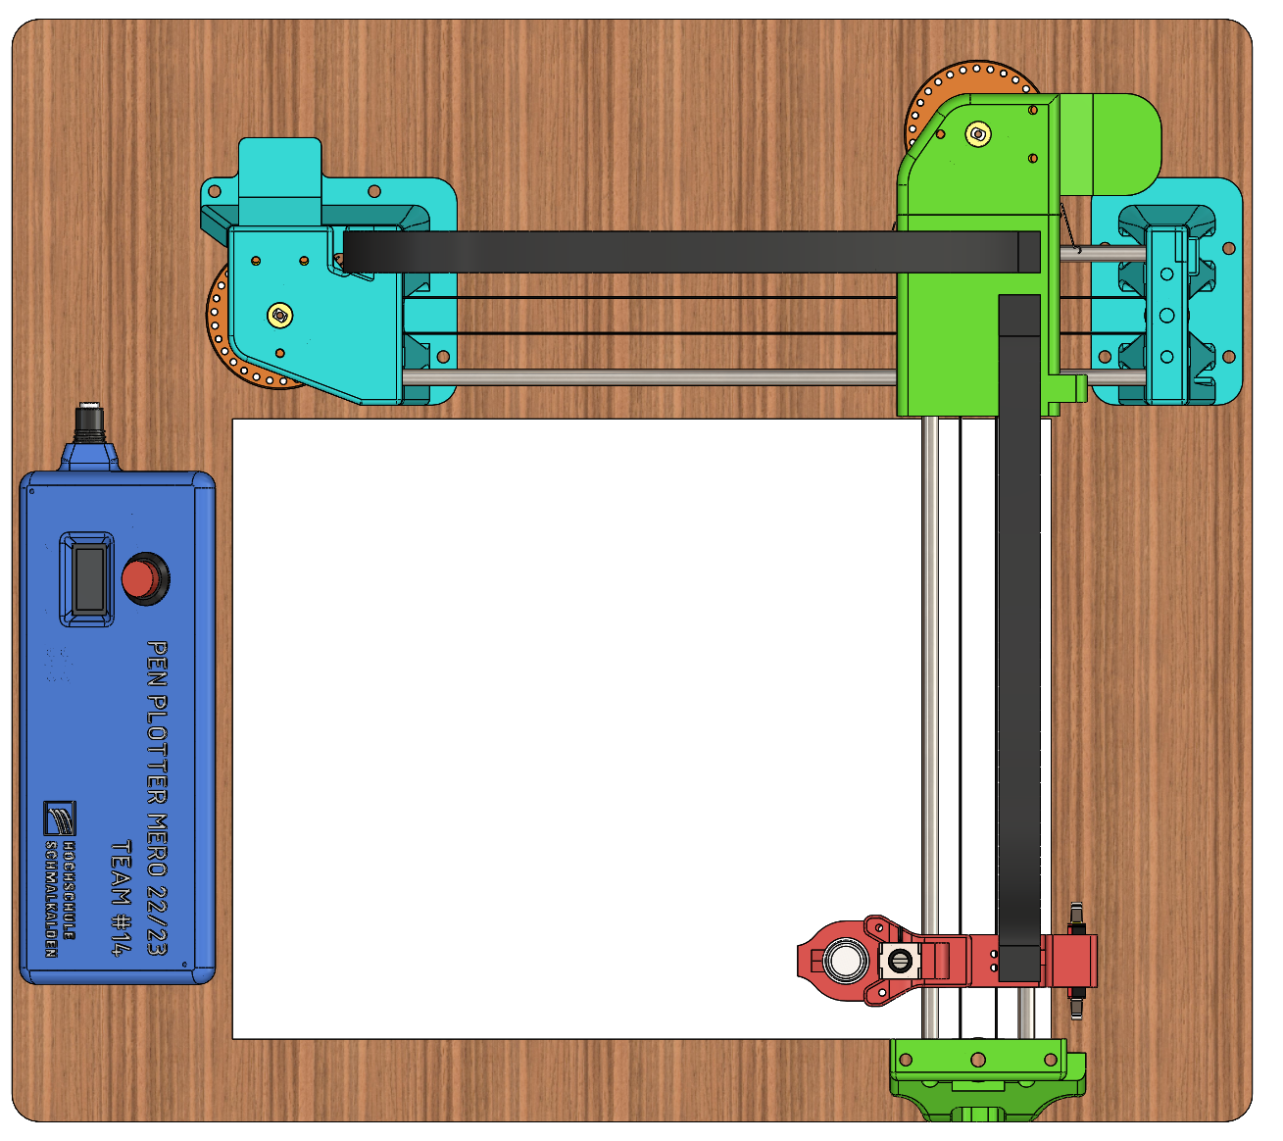

PEN PLOTTER
WORKSHOP MECHATRONICS

Slide 2
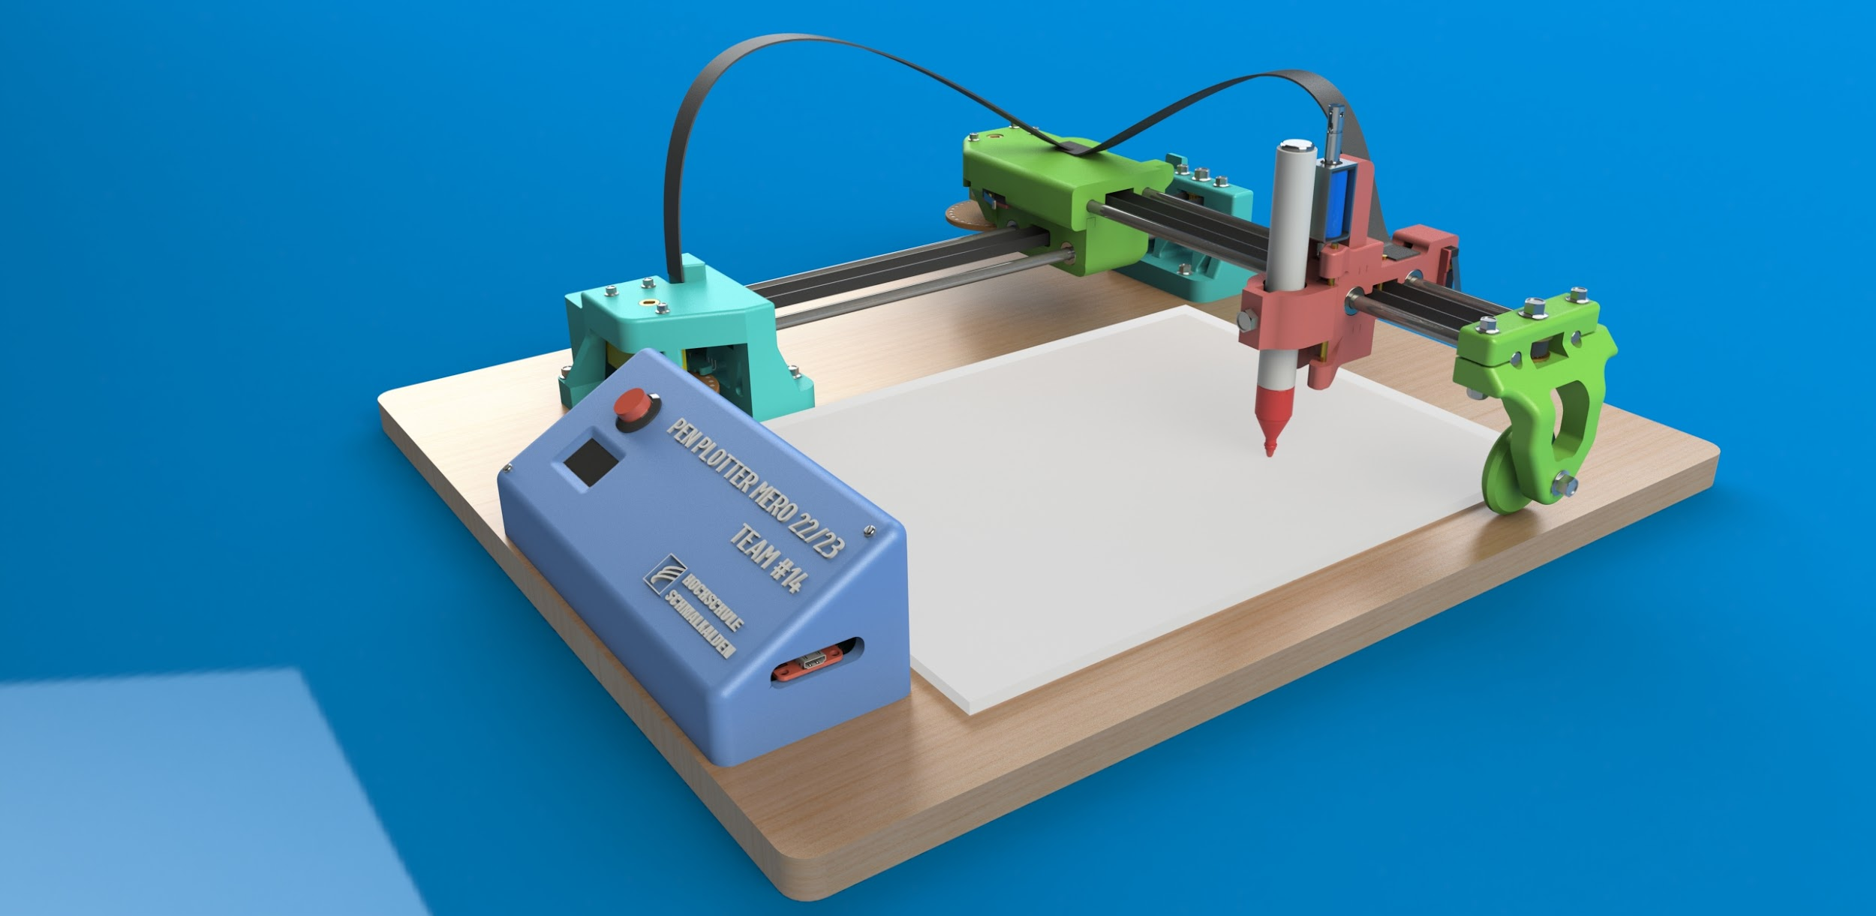
Introduction

Slide 3

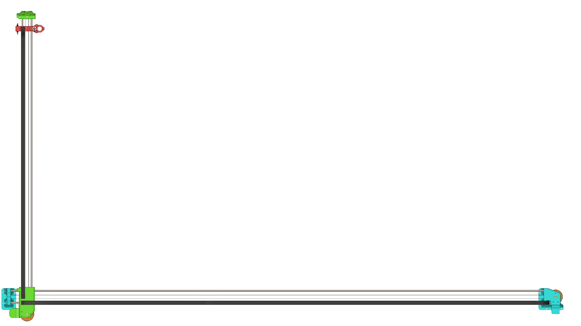
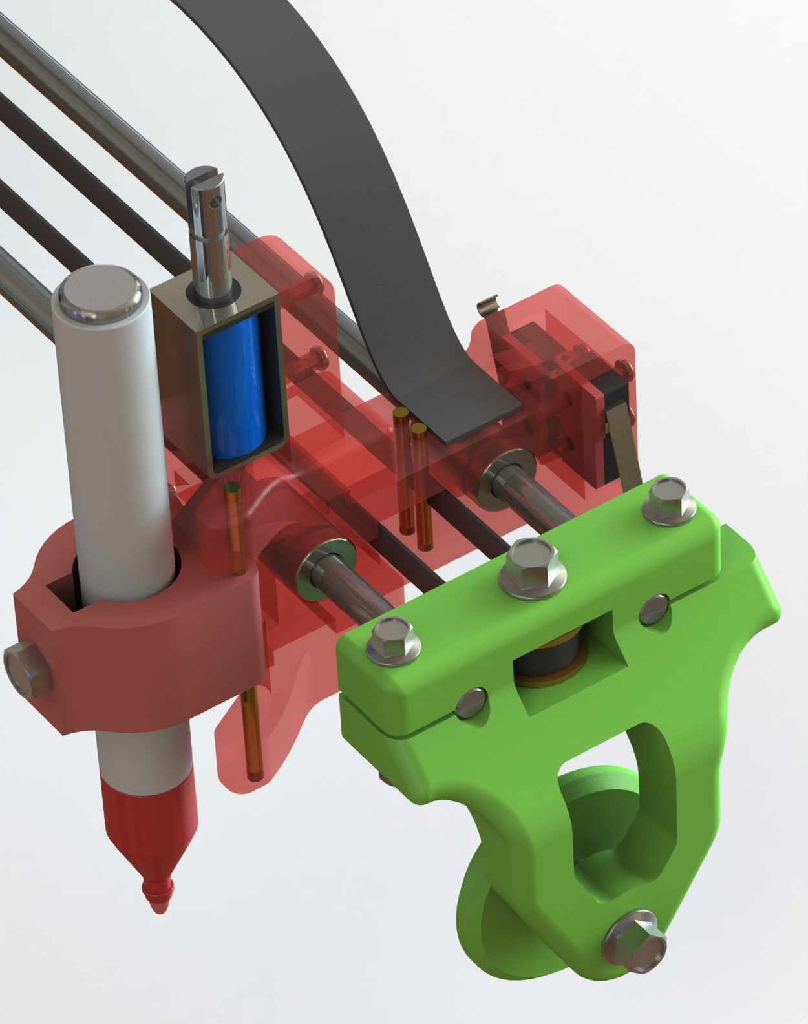
Introduction
Welcome to our presentation on the pen plotter, an exceptional product developed and fabricated by a group of enthusiastic university students as part of our workshop mechatronics project. Today, we are excited to take you through the fascinating journey of creating this innovative device, from its conceptualization to the final realization.
A pen plotter is a type of computer-controlled device that uses pens or markers to create precise and accurate drawings on paper. The project aims to develop a functional pen plotter using specific components and technologies that showcases the integration of hardware, software, and mechanical components to achieve a specific task.
In this presentation, we will guide you through the key stages of our new product development process: design, development, and fabrication. We will begin by highlighting the challenges we identified and the goals we set out to achieve. Then, we will dwell into the design stage, where we harnessed our creativity and technical expertise to develop a robust and efficient pen plotter.

Slide 4

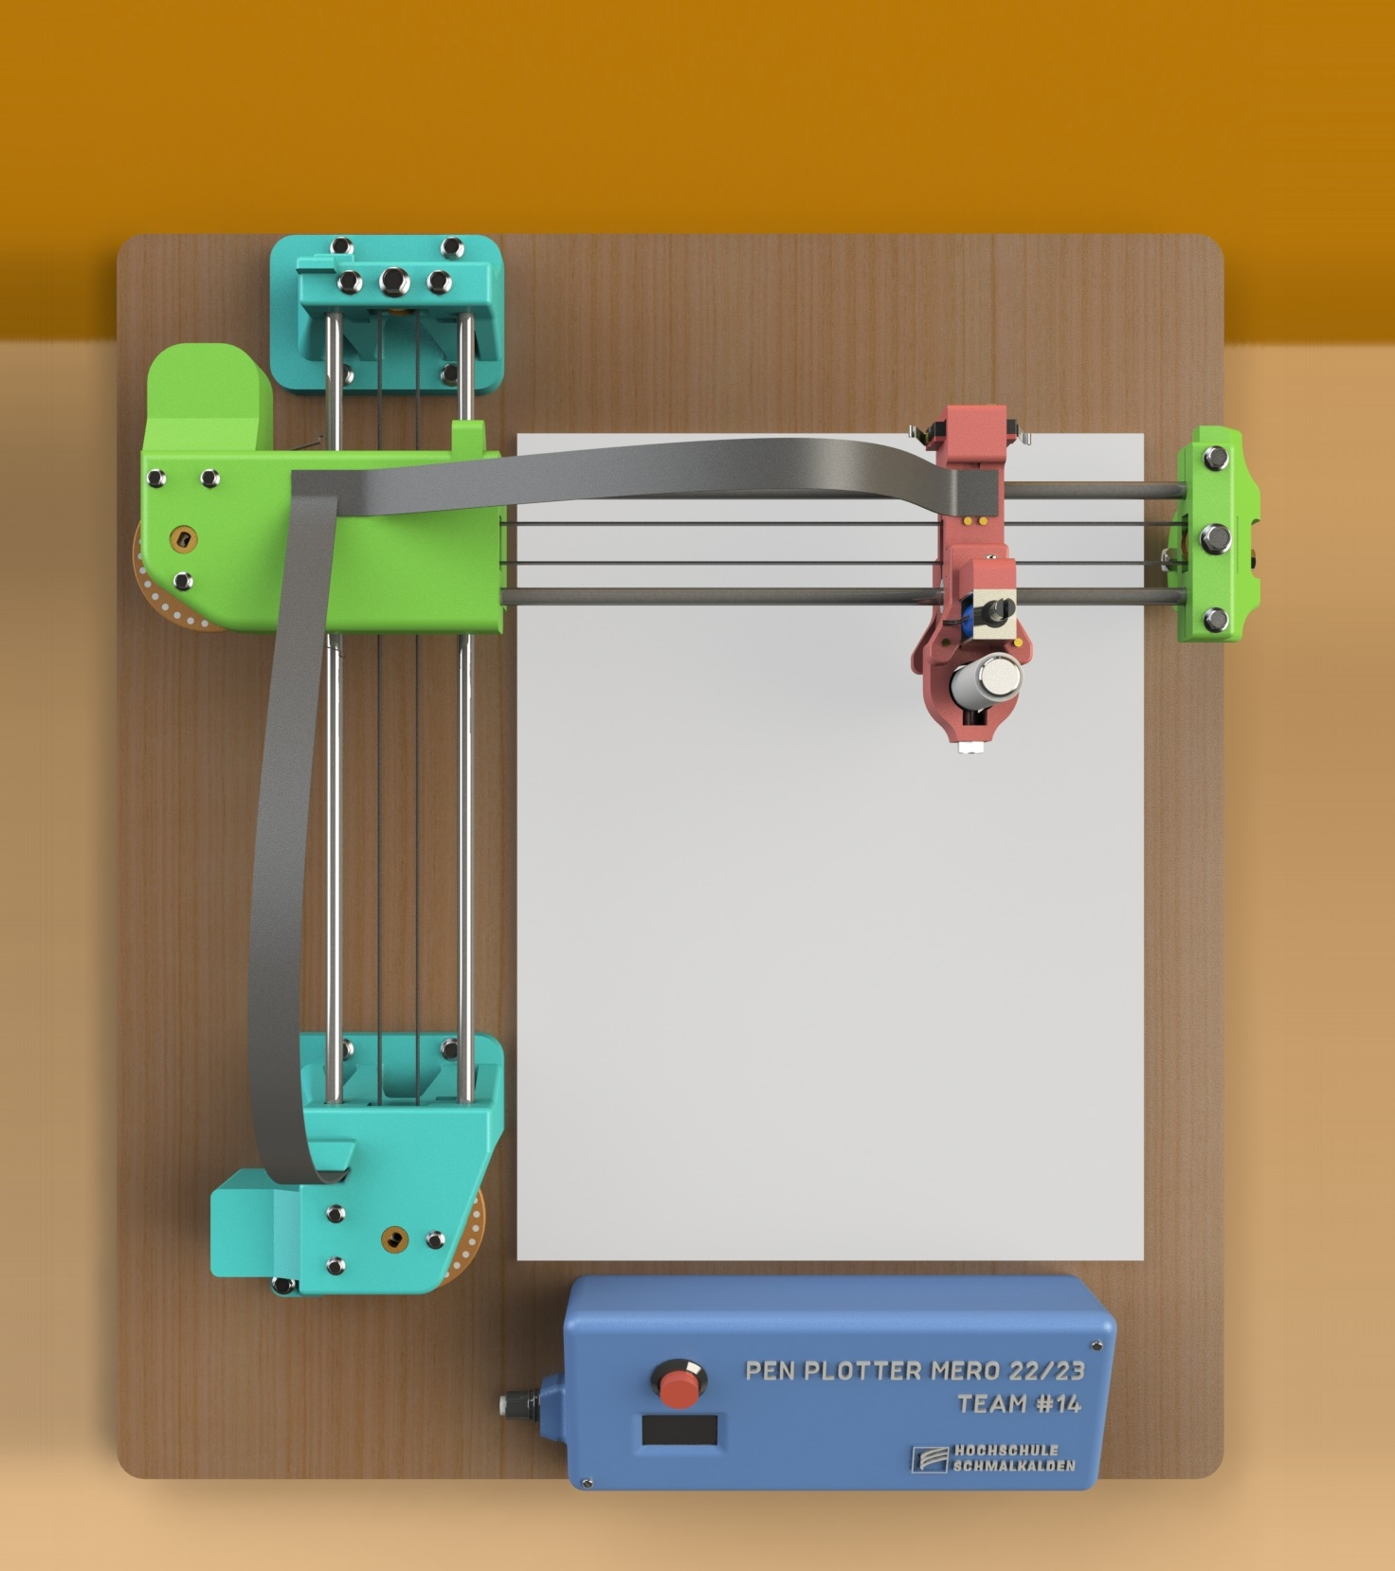
Agenda
Introduction
Project Goals & Planning
Project Goals
Organisation Chart
Timeline
V – Model
Morphological Chart
Decision Matrix
Design Stage
Component Selection
Electrical Circuit Design
Mechanical CAD Design
Key Design Decisions
Programming
Development and Fabrication Stage
Selection of materials
Use of Test piece
Challenges faced during Development stage
Iteration & Testing
Testing Procedure
Performance testing & Calibration
Conclusion
Task: Plot Nikolaus Haus
Future Scope
Demonstration

Slide 5
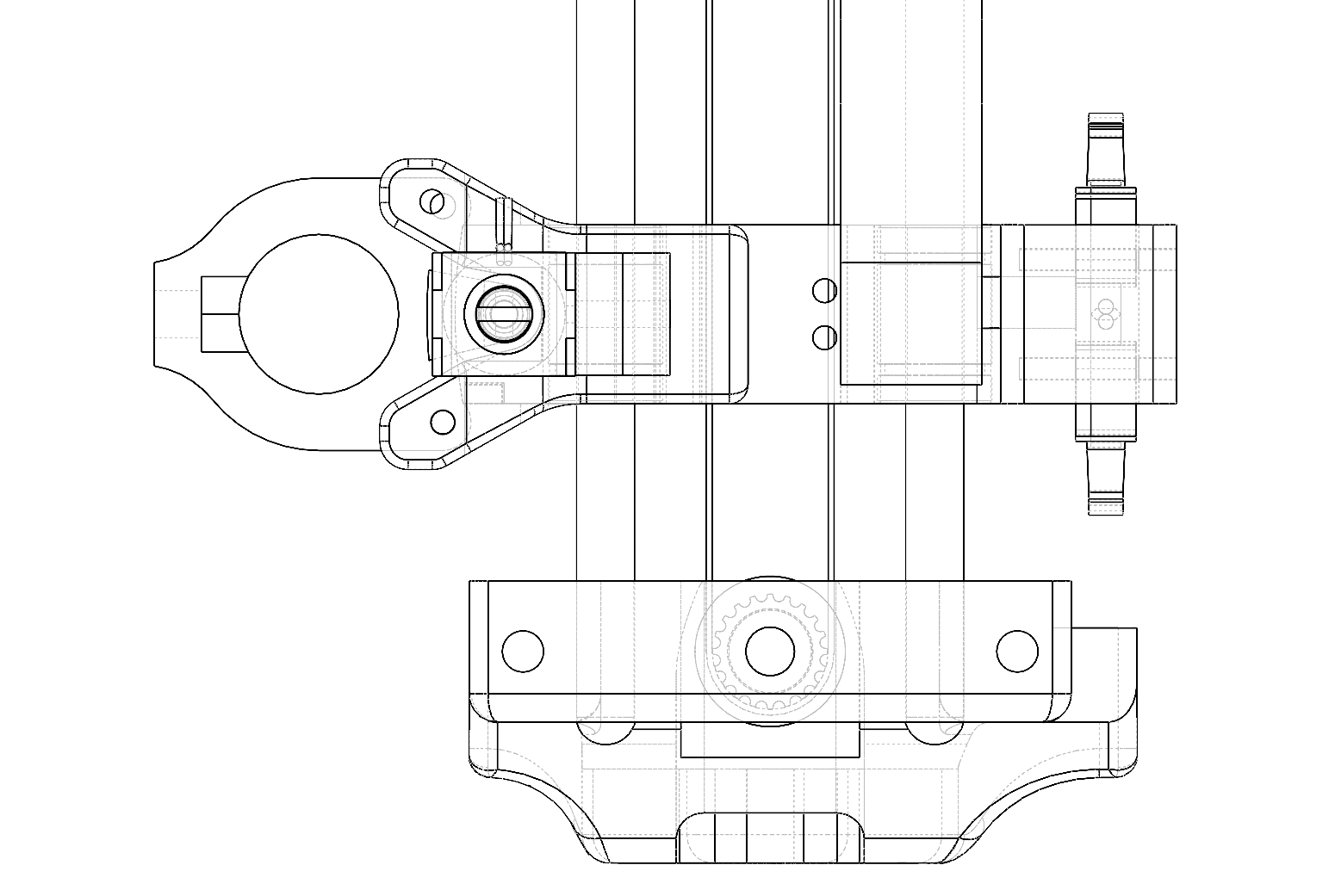
Project Goals
And Planning

Slide 6
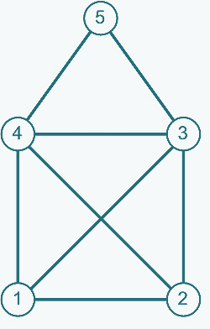
Project Goals
The primary objective of the project is to create a pen plotter by integrating all the available components. These components will be responsible for controlling the movement of the pen and ensuring accurate plotting on paper.
The project team will design and fabricate the necessary parts, program the control system, and assemble the pen plotter. The following tasks will be performed:
Designing and building a functional pen plotter using specific components.
Ensuring precise and accurate plotting on paper.
Developing a user interface to control the movement of the pen.
Testing and calibrating the pen plotter for optimal performance.
Demonstrating the functionality and output of the pen plotter through plotted designs of Nikolaus Haus.

Slide 7
Organization Chart
Prof. Dr. Stefan Roth Prof. Dr.-Ing. Silvio Bachmann
Rajat Joshi
Sagar Patil
Prabhat Gaikwad
Vinit Devchandani
Hikmaddin Abishov
CAD Design
CAD Design
Technical & Design Specifications
Validation Protocol & Validation Report
Validation Protocol
Electrical design and Coding
User requirements & Technical specs.
Validation Protocol & Validation Report
Verification Protocol & Verification Report
Verification Protocol
User requirements & Technical specs.
Design Specifications & Presentation
Project Dossier
Project Dossier & Presentation
Verification Report
Mechanical Assembly & electrical wiring
Mechanical Assembly & electrical wiring
Mechanical Assembly
Mechanical Assembly

Slide 8
Project Timeline
CAD Design & Fabrication
Testing & Calibration
(1st May 2023 – 10th June 2023)
(10th June 2023 – 22nd June 2023)
Documentation, Verification & Validation
Coding and User interface linking
(25th May 2023 – 20th June 2023)
(1st June 2023 – 5th July 2023)

Slide 9
V - Model
User Requirement:
To Draw Nicolas House using XY Pen Plotter
Weight should be less than 3.5 kgs
Size should be within 56x39x42 cm
Product (XY Pen Plotter):
Verification of all the requirements
Demonstration & running test
Software Test Protocol & Test Report:
Testing codes to control features like path planning, motor control & pen holder movement
Describing the test procedures, observations, and results in a test report.
Software specifications:
Programming & User Interface using Arduino IDE 2.1.0
Designing of parts using DSS Solidworks
Mechanical specifications :
Manufacturing of components using 3D printer with 80% infill for rigidity.
Standard GT2 drive belts to resist elongation while in operation.
Mechanical Test Protocol & Test Report:
Verify the print quality & dimensions of 3D printed parts
Evaluate the mechanical performance of the pen plotter
Document the test procedures, observations, and results in test report
Hardware specifications :
Use 2 DC geared motors & ESP32 board for design.
Motor Drivers, limit switches & Start switch have to be used along with Emergency Stop button
Hardware Test Protocol & Test Report:
Testing the aspects like sensor accuracy, motor functionality, limit switches and power management
Compiling the test procedures, observations, and results in the test report
Design Specifications & Implementation
Using additive manufacturing, all the 3D designed parts should be printed.
Implementing the coding, necessary algorithms and functionalities.
Specify the circuit layout for the electronics, considering factors like component placement, aesthetic cable routing, and power distribution

Slide 10
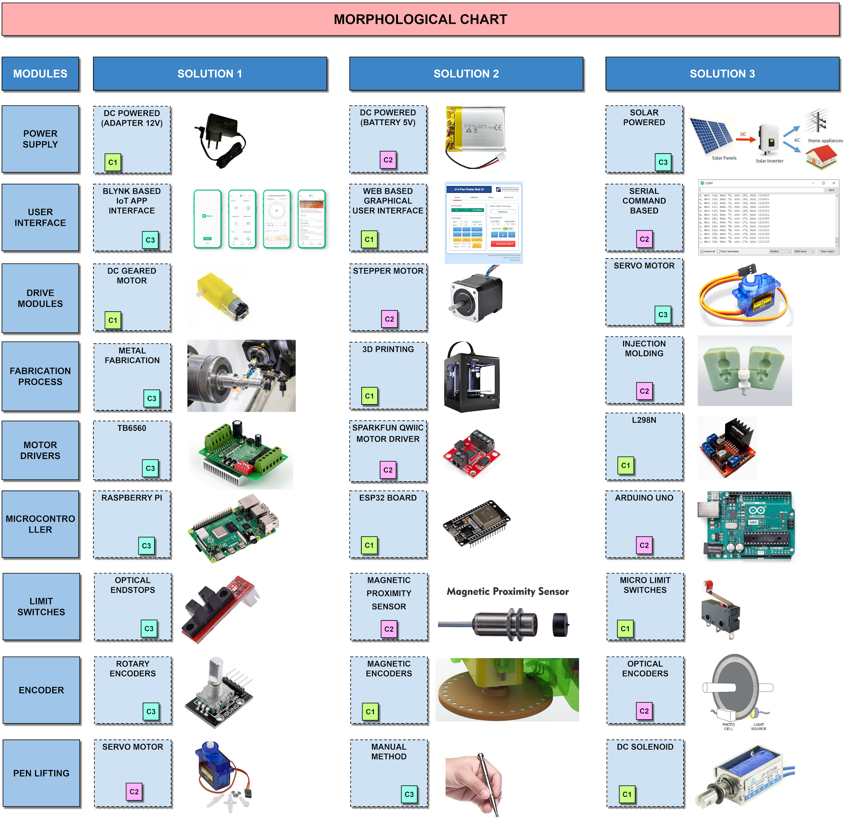
Morphological Chart
Design concepts from morphological chart
MODULES | CONCEPT - 1 | CONCEPT - 2 | CONCEPT - 3
POWER SUPPLY | DC POWERED | DC POWERED | SOLAR POWERED
 | (ADAPTER 12V) | (BATTERY 5V)
USER INTERFACE | WEB BASED GRAPHICAL USER INTERFACE | SERIAL COMMAND BASED | BLYNK BASED IoT APP INTERFACE
DRIVE MODULE | DC GEARED MOTOR | STEPPER MOTOR | SERVO MOTOR
FABRICATION PROCESS | 3D PRINTING | INJECTION MOLDING | METAL FABRICATION
MOTOR DRIVERS | L298N | SPARKFUN QWIIC MOTOR DRIVER | TB6560
MICROCONTROLLERS | ESP32 BOARD | ARDUINO UNO | RASPBERRY PI
LIMIT SWITCHES | MICRO LIMIT SWITCHES | MAGNETIC PROXIMITY SENSOR | OPTICAL ENDSTOPS
ENCODER | MAGNETIC ENCODERS | OPTICAL ENCODERS | ROTARY ENCODERS
PEN LIFTING | DC SOLENOID | SERVO MOTOR | MANUAL METHOD

Slide 11
Decision Matrix
PAIRWISE COMPARISON
CRITERIA | RATING RANGE | WEIGHT | CONCEPT 1 |  | CONCEPT 2 |  | CONCEPT 3
 |  |  | POINTS | POINTS * WEIGHT | POINTS | POINTS * WEIGHT | POINTS | POINTS * WEIGHT
COST | 1- >200€ 3- 150€ to 200€ 5- <150€ | 12.2% | 5 | 0.61 | 1 | 0.12 | 3 | 0.37
DRAWING QUALITY | 1- Accuracy > 5mm 3- 1mm < Accuracy < 5mm 5- Accuracy < 1mm | 23.3% | 5 | 1.17 | 3 | 0.70 | 1 | 0.23
DRAWING SPEED | 1- Drawing Time > 2min 3- 1min < Time < 2min 5- Drawing Time < 1min | 14.4% | 3 | 0.43 | 5 | 0.72 | 1 | 0.14
DURABILITY | 1- Compressed wood construction 3- Wood construction 5- Metal base construction | 23.3% | 1 | 0.23 | 3 | 0.70 | 5 | 1.17
PORTABILITY | 1- >5 kg 3- 3.5kg to 5kg 5- < 3.5kg | 10.0% | 5 | 0.50 | 3 | 0.30 | 1 | 0.10
UI / EASE OF USE | 1- Coding interface 3- IOT Interface 5- HTML WebUI GUI | 16.7% | 5 | 0.83 | 1 | 0.17 | 3 | 0.50
CHECK SUM |  | 100.0% | 24.00 | 3.78 | 16.00 | 2.71 | 14.00 | 2.51
1 - 3 - 5 Point System
AS MORE IMPORTANT | COST | DRAWING QUALITY | DRAWING SPEED | DURABILITY | PORTABILITY | UI / EASE OF USE | SUM ∑ | PERCENTAGE %
COST |  | 3 | 5 | 1 | 1 | 1 | 11 | 12.2%
DRAWING QUALITY | 3 |  | 5 | 5 | 5 | 3 | 21 | 23.3%
DRAWING SPEED | 1 | 1 |  | 1 | 5 | 5 | 13 | 14.4%
DURABILITY | 5 | 1 | 5 |  | 5 | 5 | 21 | 23.3%
PORTABILITY | 5 | 1 | 1 | 1 |  | 1 | 9 | 10.0%
UI / EASE OF USE | 5 | 3 | 1 | 1 | 5 |  | 15 | 16.7%
 |  |  | CHECK SUM |  |  |  |  | 100%
Criterion A Is More Important Than Criterion B => 5 Points For A
Criterion A Is Equal To Criterion B => 3 Points For A and B
Criterion A Is Less Important Than Criterion B => 1 Point For A
WINNING CONCEPT

Slide 12
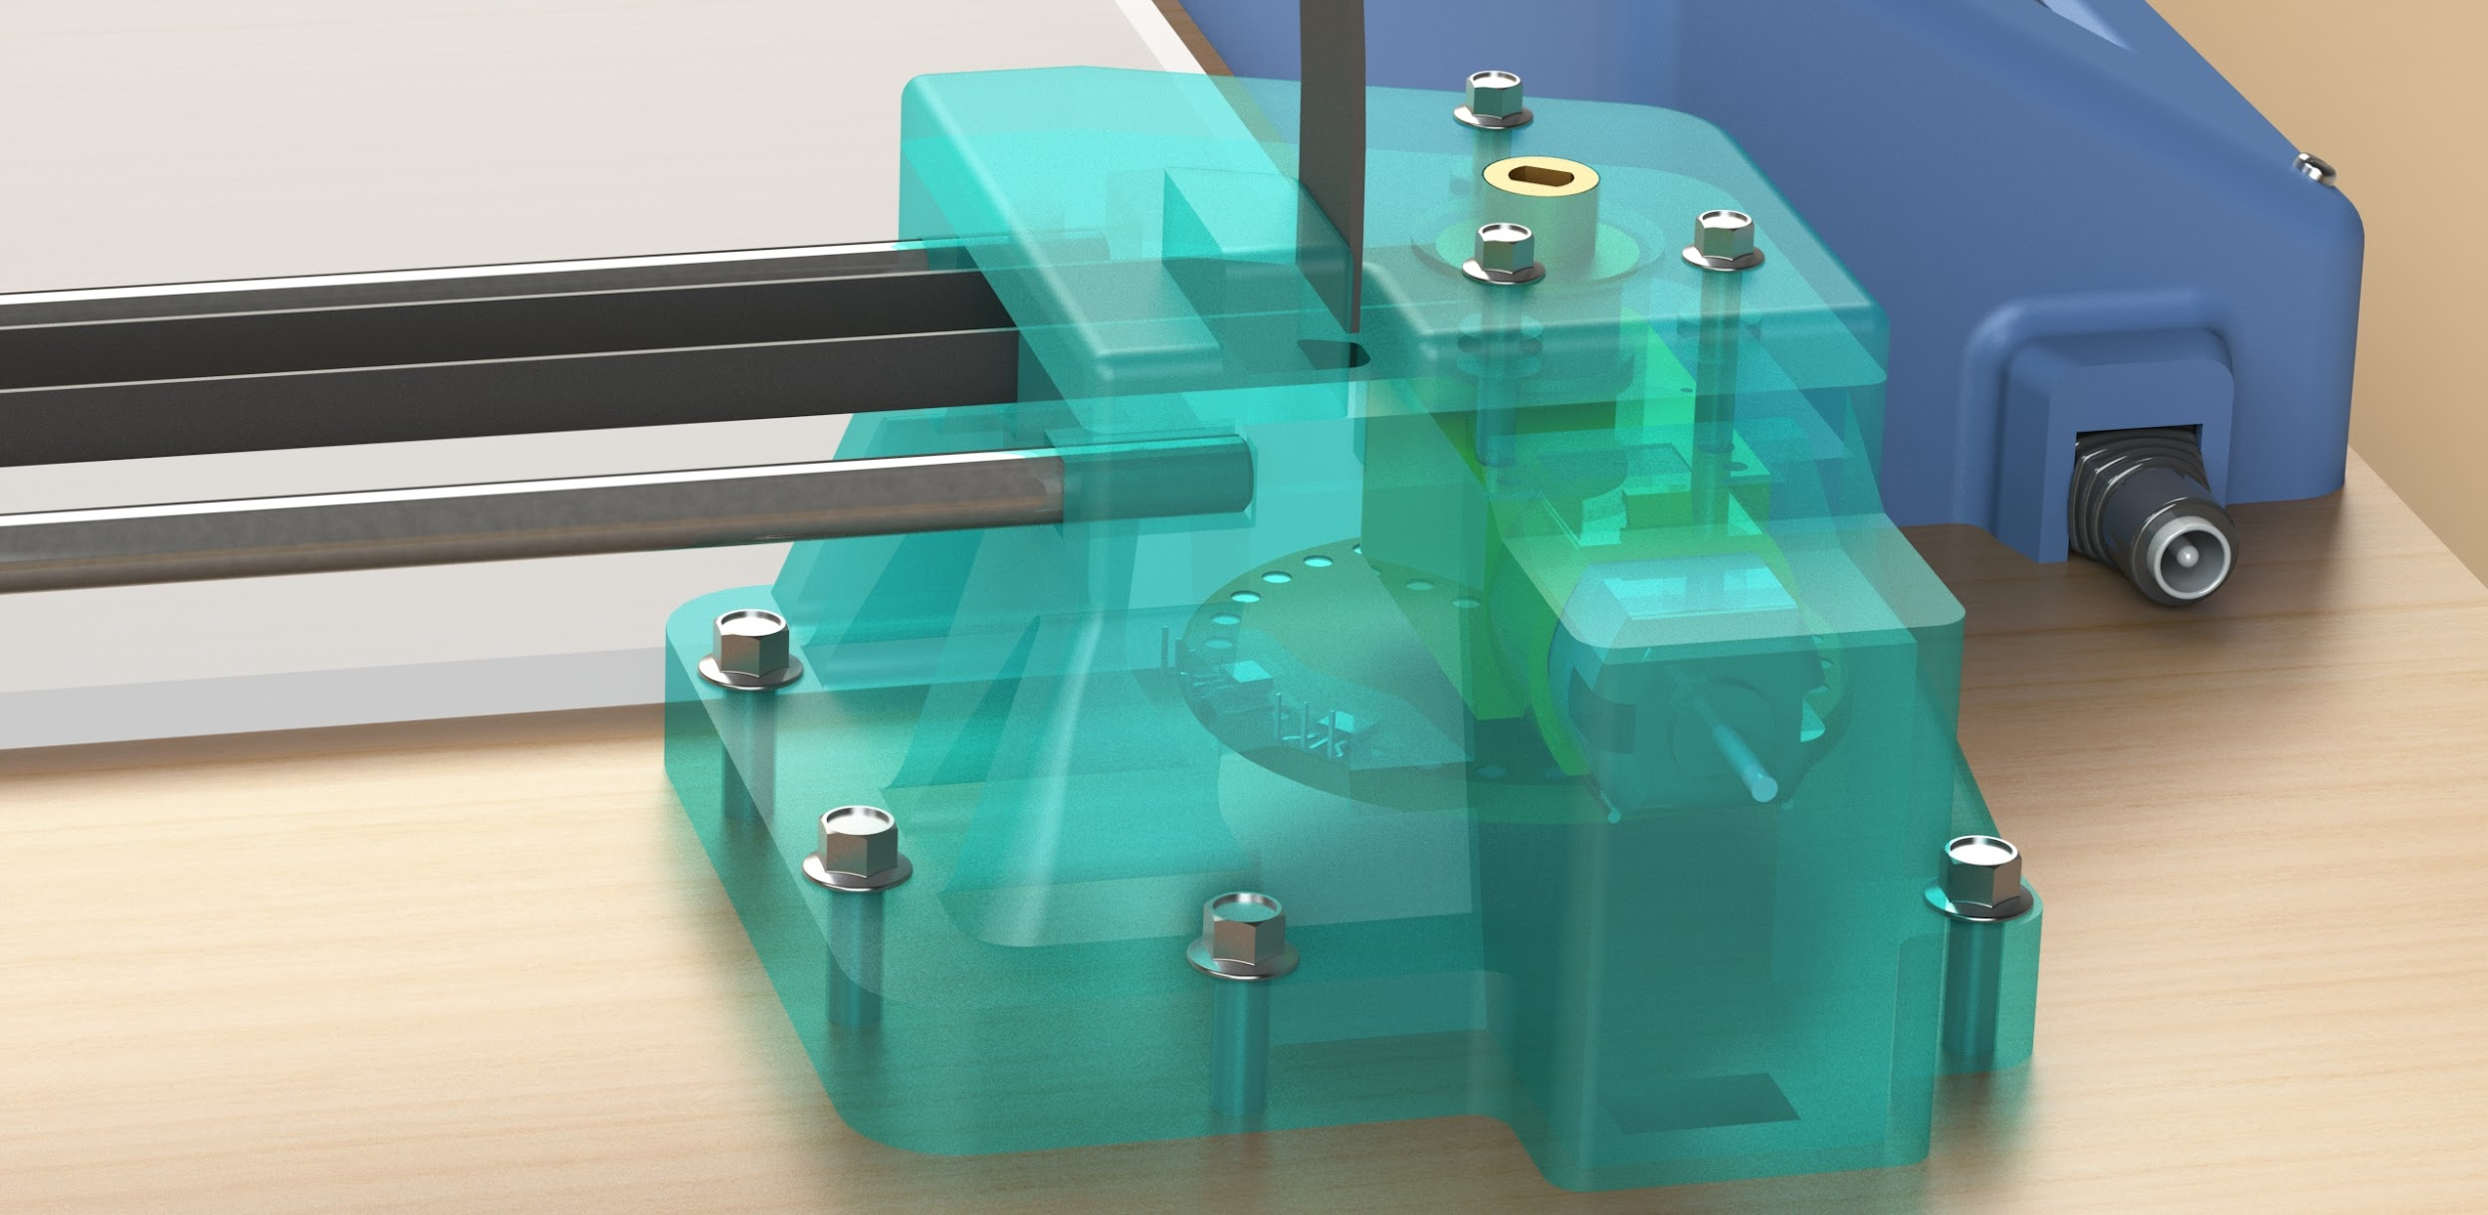
Design Stage

Slide 13
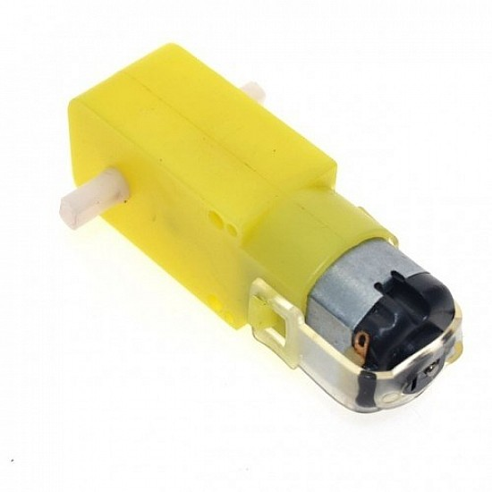
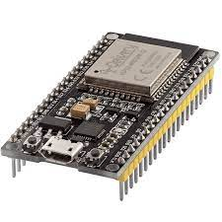
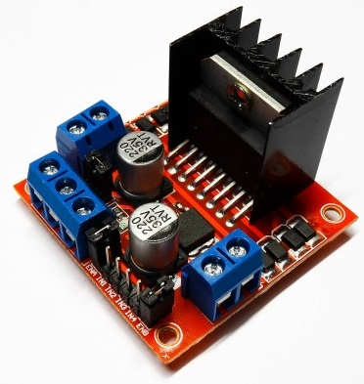
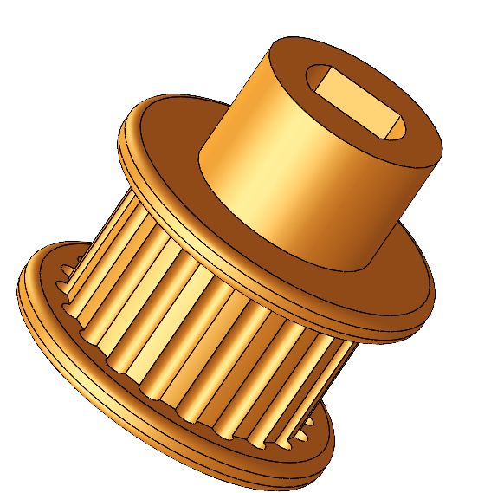
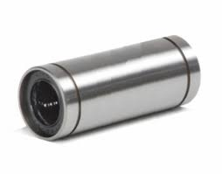
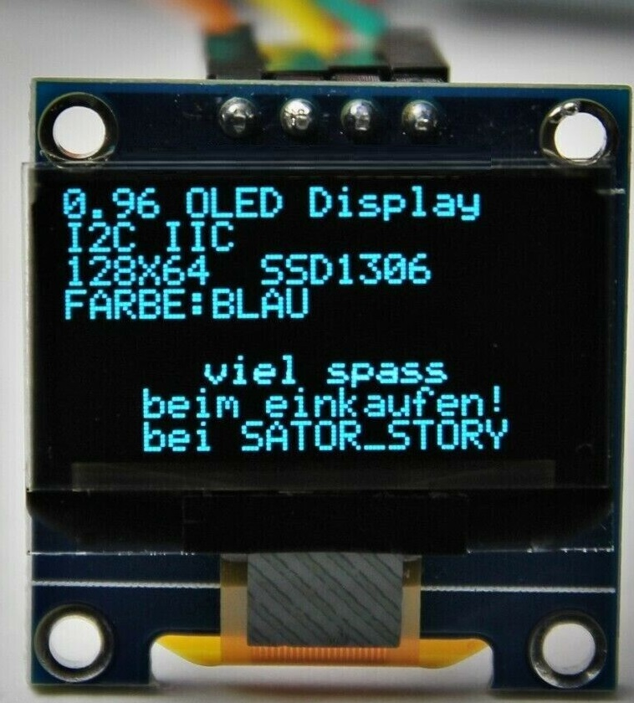
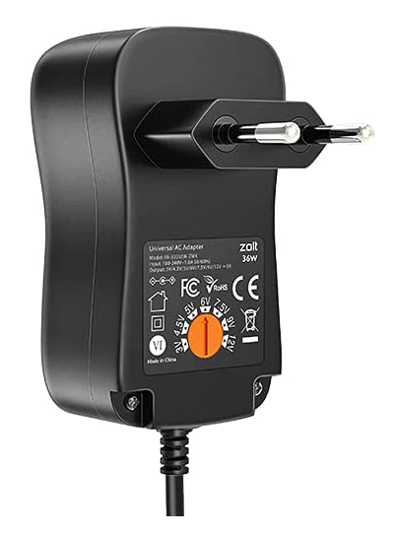
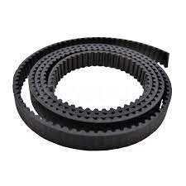
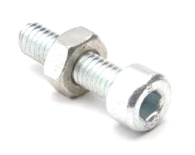
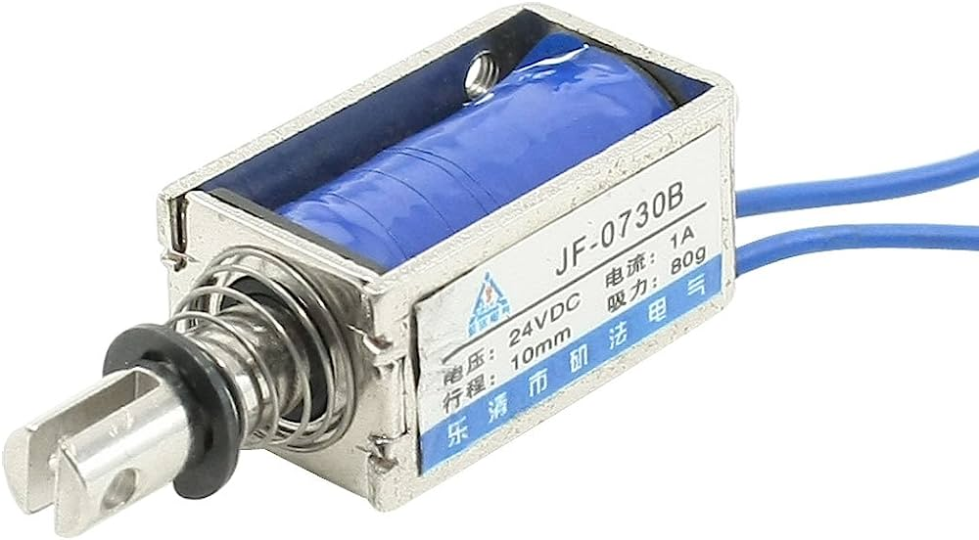
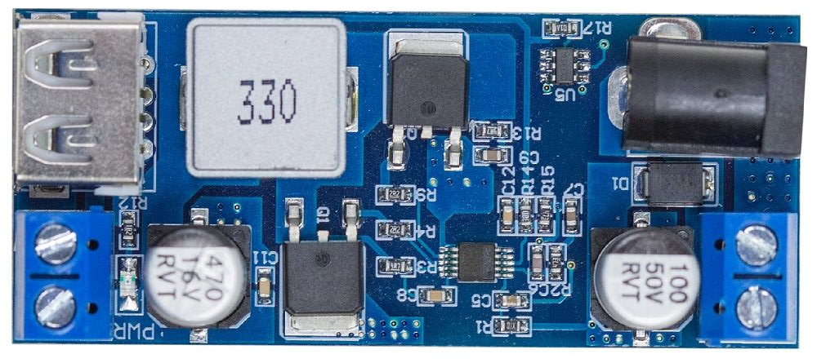
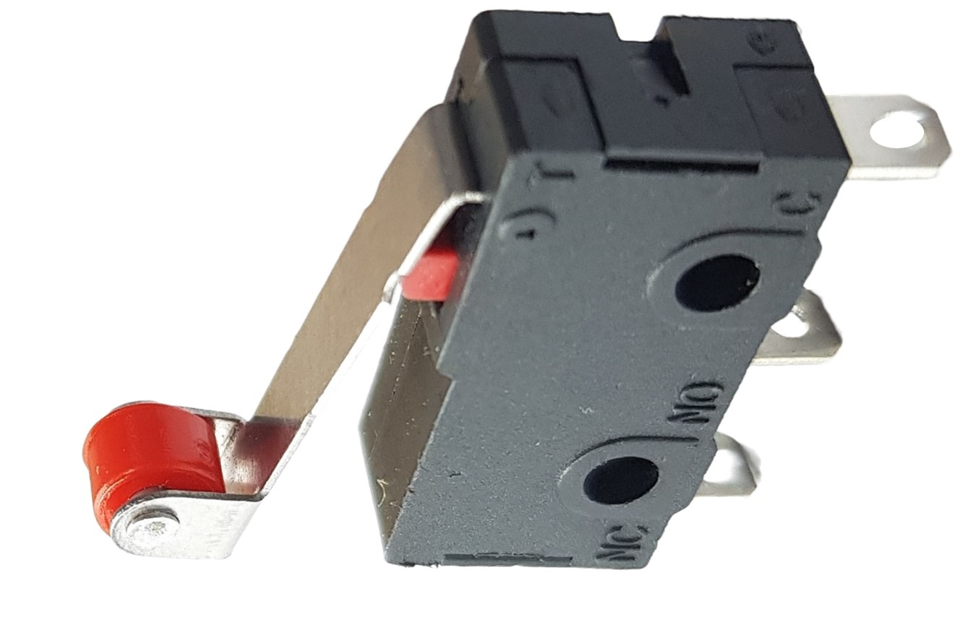
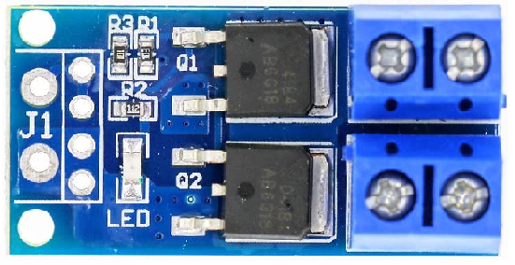
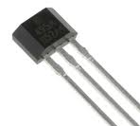
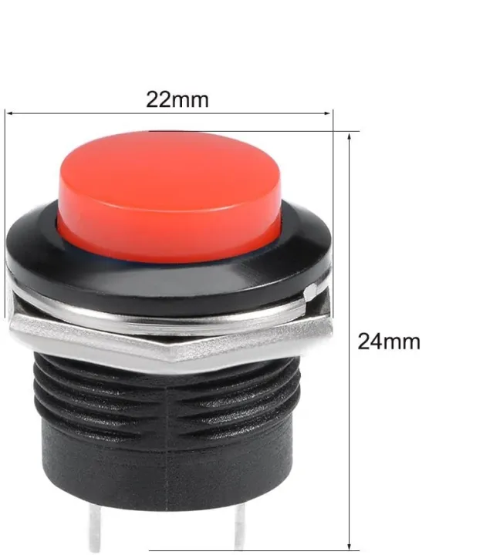
Components
L298N MOTOR
DRIVER
PULLEY
LINEAR BALL BEARINGS
DC MOTOR
ESP32 BOARD
DC SOLENOID ELECTROMAGNET
ADAPTER
(DC POWER)
GT2 DRIVE BELT
SCREWS & FASTENERS
OLED DISPLAY
MICRO LIMIT SWITCH
MOSFET SWITCH
49E HALL SENSOR
DC-DC VOLTAGE CONVERTER
PUSH BUTTON

Slide 14
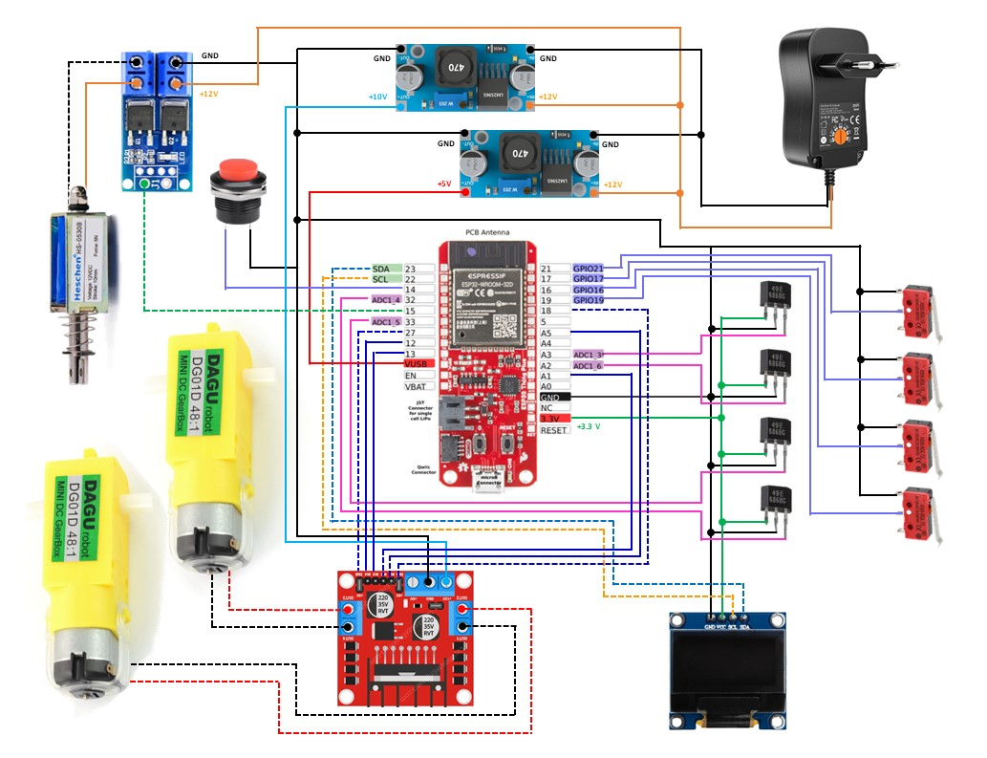
Electrical Circuit Design
Voltage Regulator
MOSFET Switch
Power Supply :
12v 3A DC adapter as main power supply unit.
Independent voltage regulators to adjust motor driver and esp-32 voltage separately.
Controllers & Drivers:
ESP-32 microcontroller, L298N Motor Driver , MOSFET Switch
Actuators :
6-12v DC Geared Motors with 48:1 gear reduction as main drive for X & Y Axis.
12vDC 5N Solenoid for pen up & down motion.
Sensors :
4 Hall sensors used as encoders for position feedback.
4 Limit switches for calibration & collision detection in X-Y plane.
User Interface:
0.96 inch OLED display for plotter status ,notifications & warning.
Red push button for engaging E-stop in case of emergency.
Perf-board and twisted pair cables are used for the construction of circuit instead of breadboard to avoid signal noise due to loose connections and interference, improving overall reliability and accuracy of the system.
DC Solenoid
ESP-32
X4 Hall Sensor
X4 Limit Switch
Motors X2
L298N Motor Driver
OLED Display

Slide 15
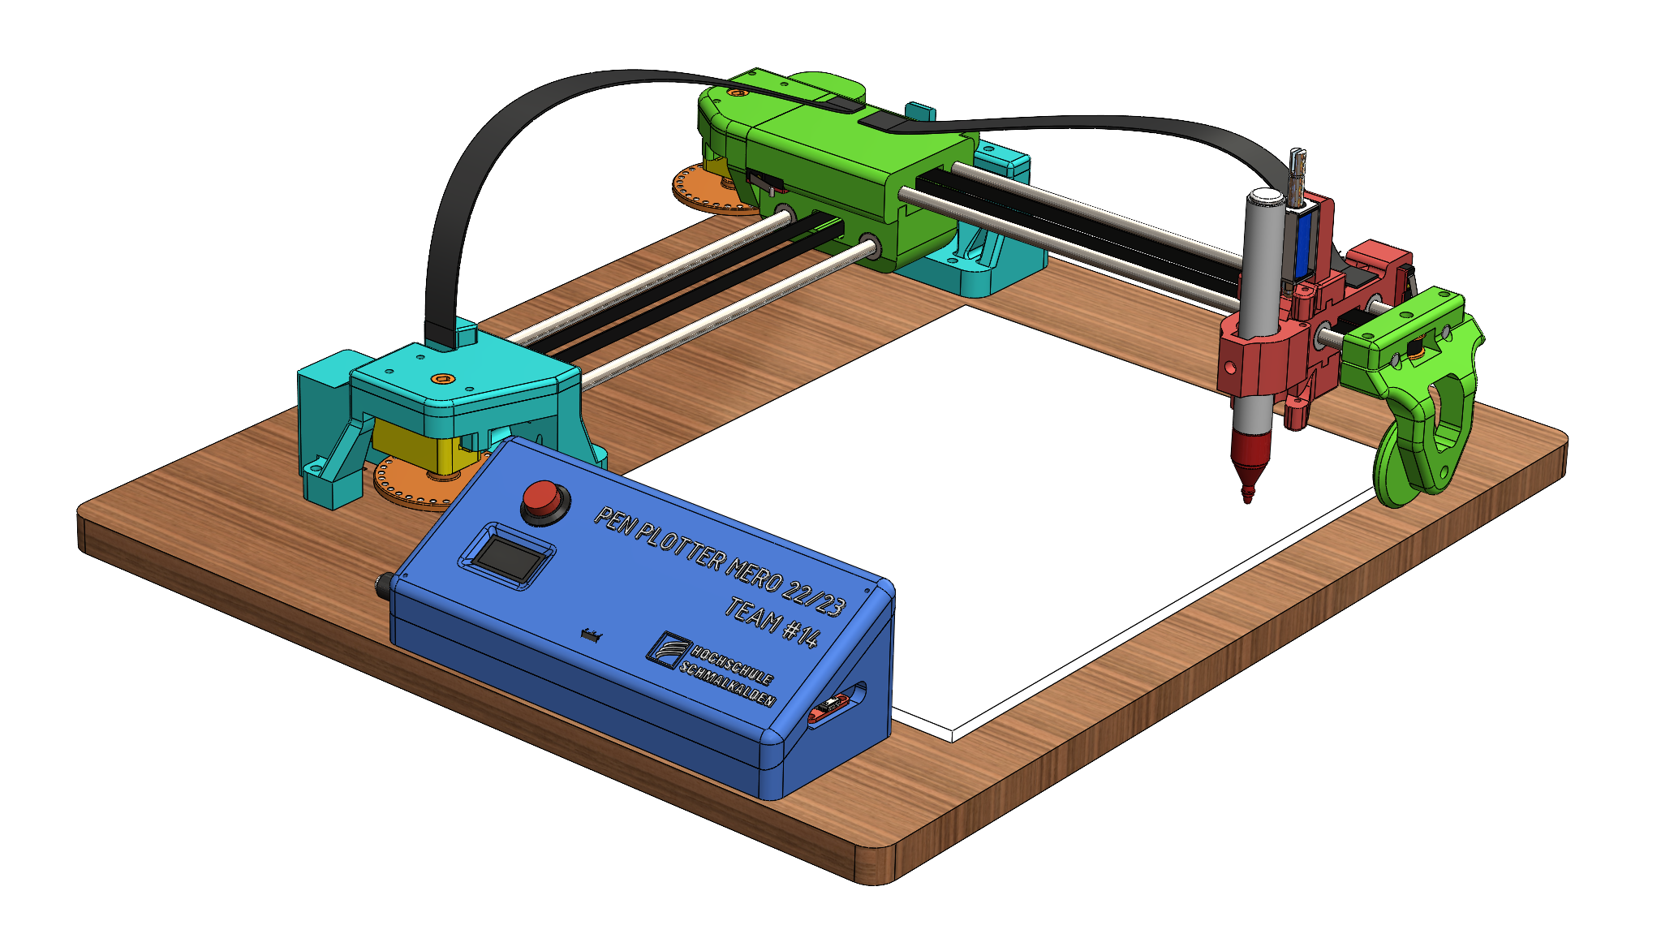
Mechanical Design
X-axis carriage
The major aim of mechanical design is to create a robust and functional Pen Plotter which ensures smooth & precise operation.
The following components were designed accurately by using DSS SolidWorks:
a) Frame and Structure
b) Carriage and Slides
c) Pulley and its fixtures
d) Pen Holder
NOTE: Standard components like DC geared motor , ESP32 microcontroller board, L298N motor driver, 0.96” OLED display, DC solenoid 5N,etc were downloaded and dimensions were verified with those of physical components.
Limit Switch (Y min)
Y-axis pulley fixture
Magnetic Encoder wheel
DC geared motor
DC solenoid 5N
Y-axis motor fixture
X-axis Pulley fixture
OLED display
Electronic circuit Housing
Pen carriage

Slide 16
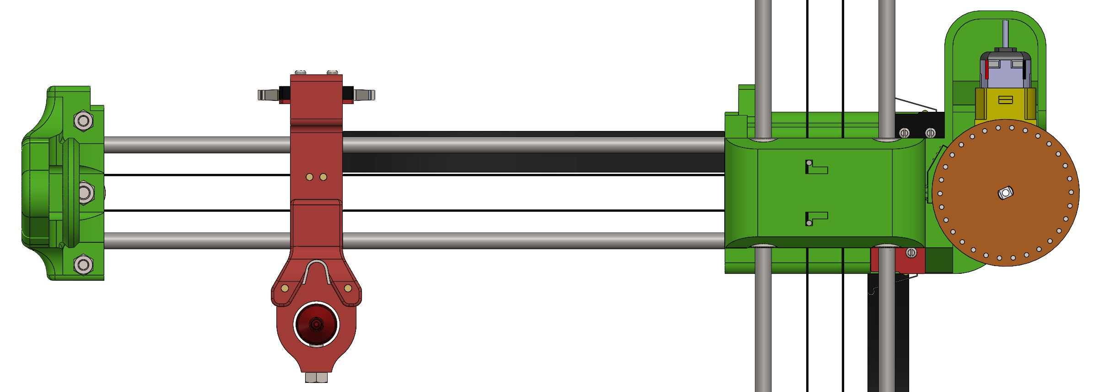
Key design decisions
Decisions related to design play a crucial role in shaping the user experience of the Pen Plotter.
Choosing the right components, materials, and mechanisms ensures that the Pen Plotter performs its intended tasks effectively and efficiently.
By making user-centric design decisions, the Pen plotter can be more user-friendly, aesthetically pleasing and enjoyable to operate. Following are the optimal design choices made by our team:
Position of limit switch for better wiring
The fixtures were made considering the wiring network of Limit switches, preventing localized wire dispersal and unsightly visibility.
Limit Switch (Y min)
Limit Switch (Y max)
Limit Switch (X max)
Limit Switch (X min)

Slide 17
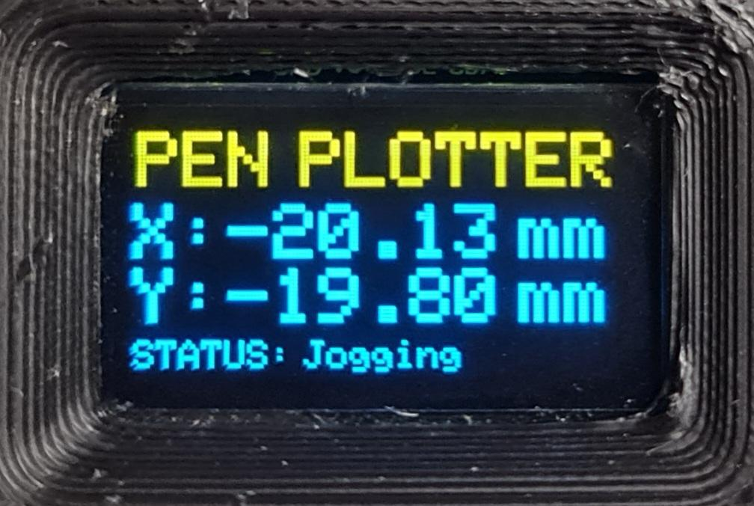
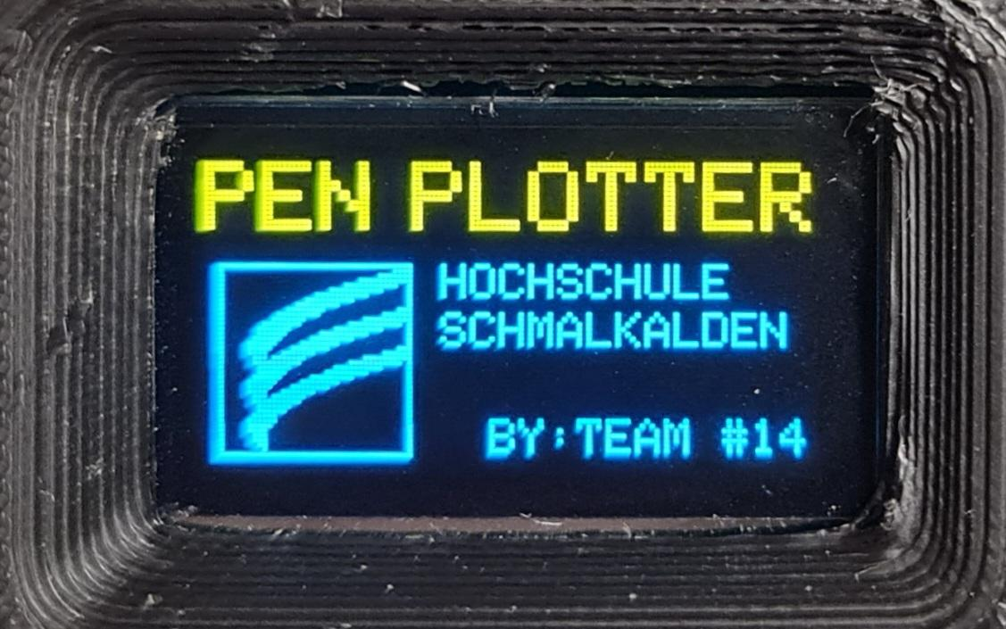
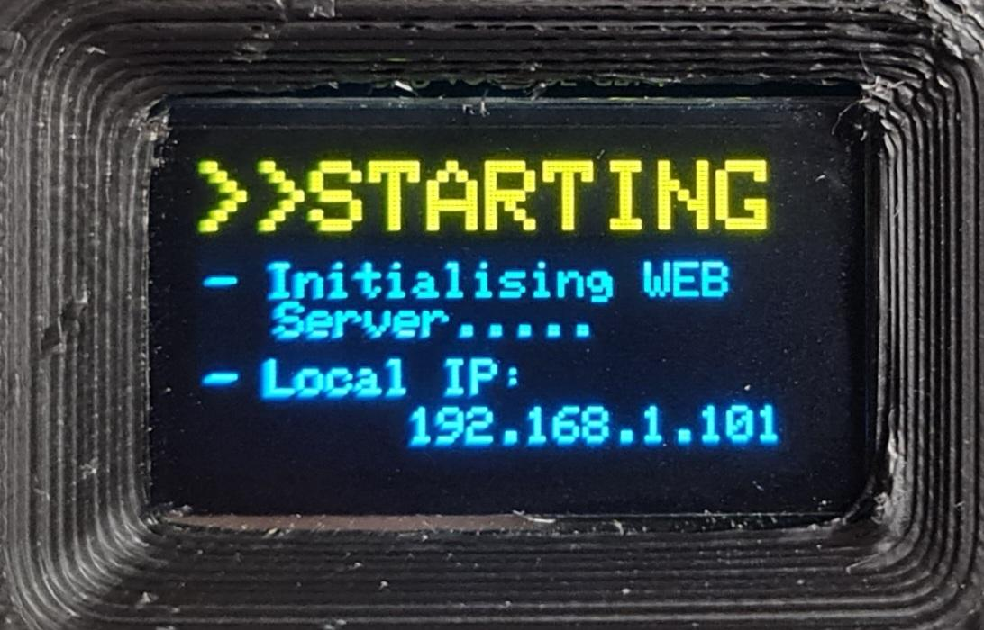
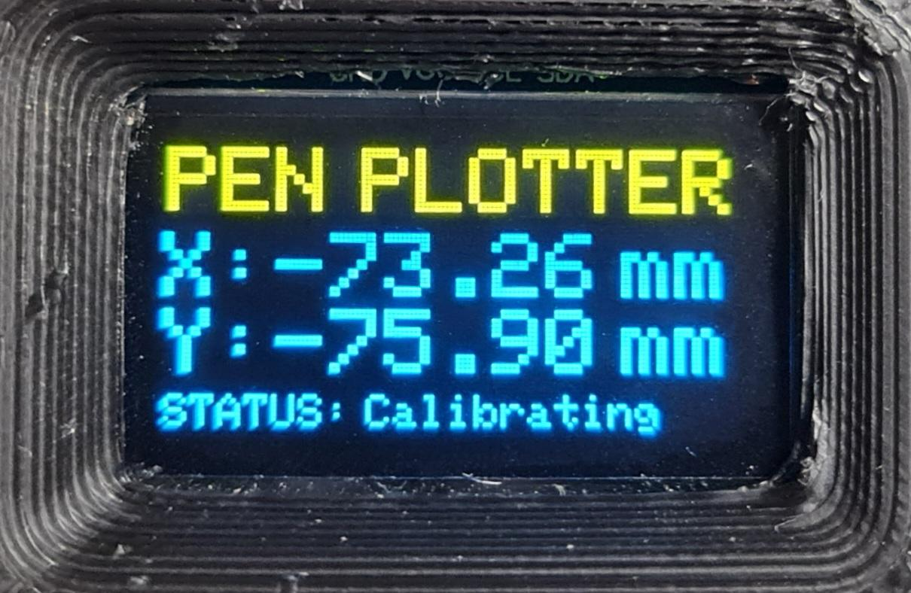
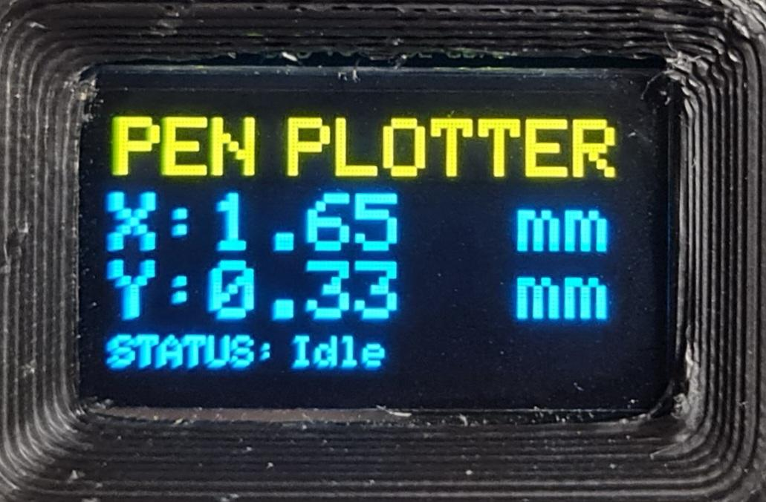
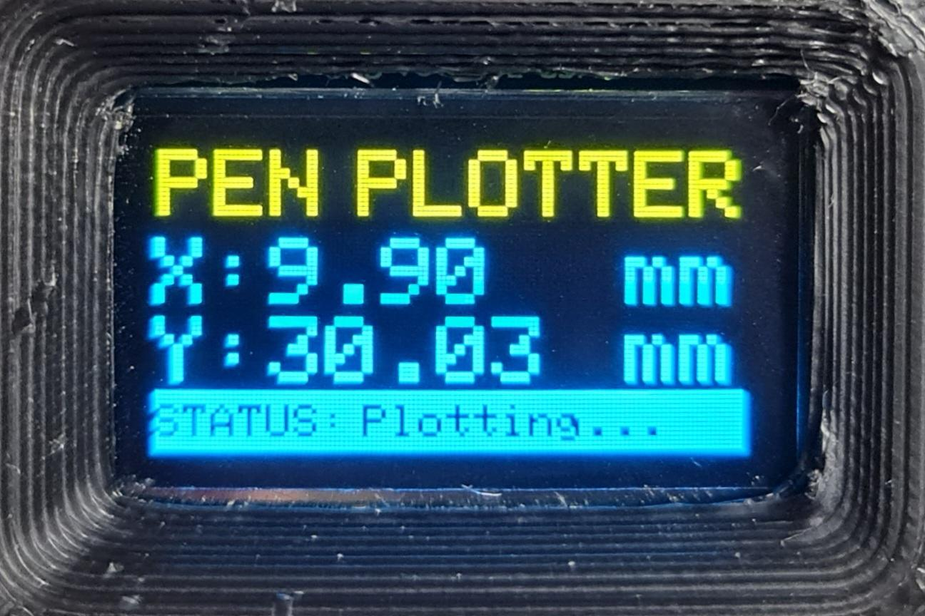
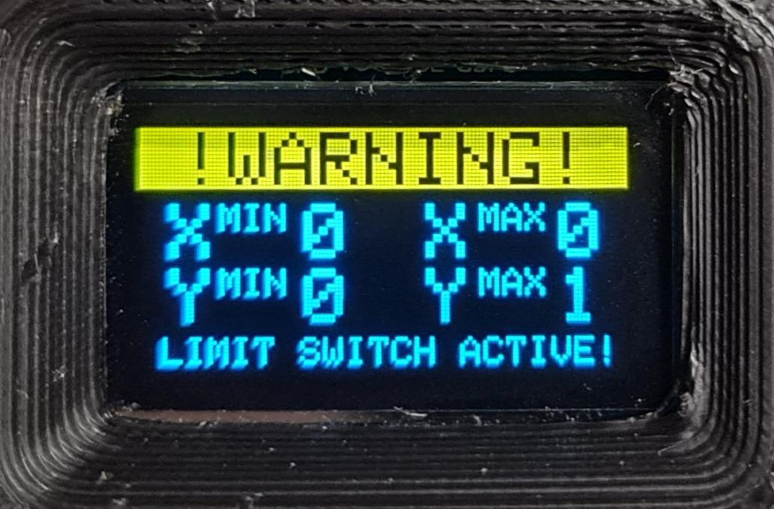
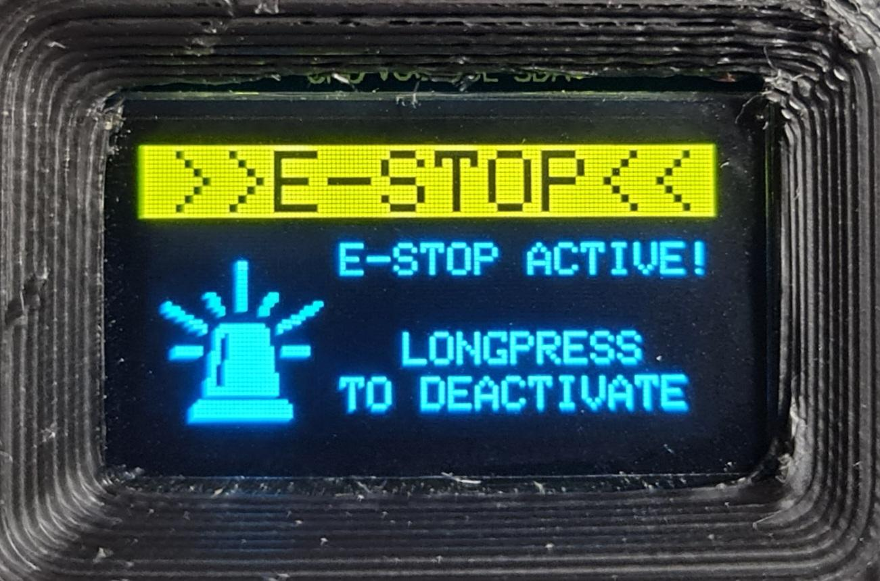
Key design decisions
Use of Display Screen
We have used 0.96inch OLED display to following features:
Welcome Screen
Web server initialization & local IP
Home Screen with XY Position & Status of Pen plotter: Jogging/ Calibrating/ Idle/ Plotting
Warning Screen: Displays the status of all limit switches
E-Stop active screen with instructions.
1
2
3.1
3.2
3.3
3.4
4
5

Slide 18
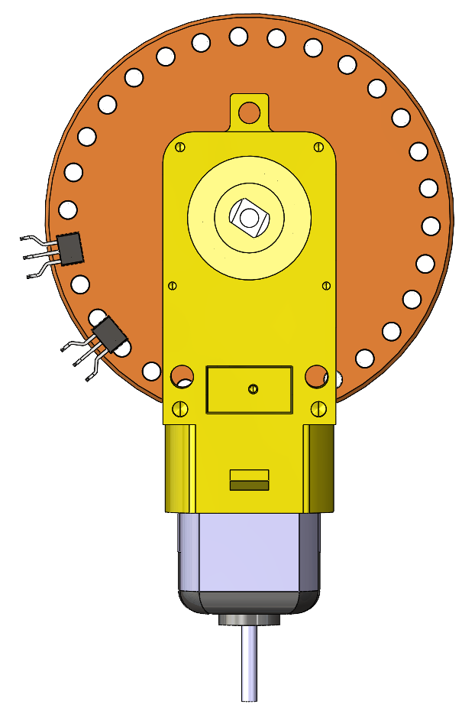
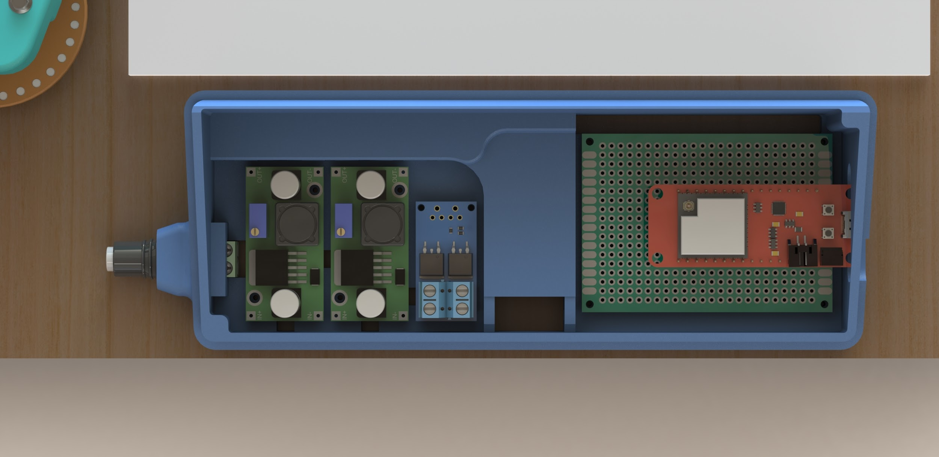
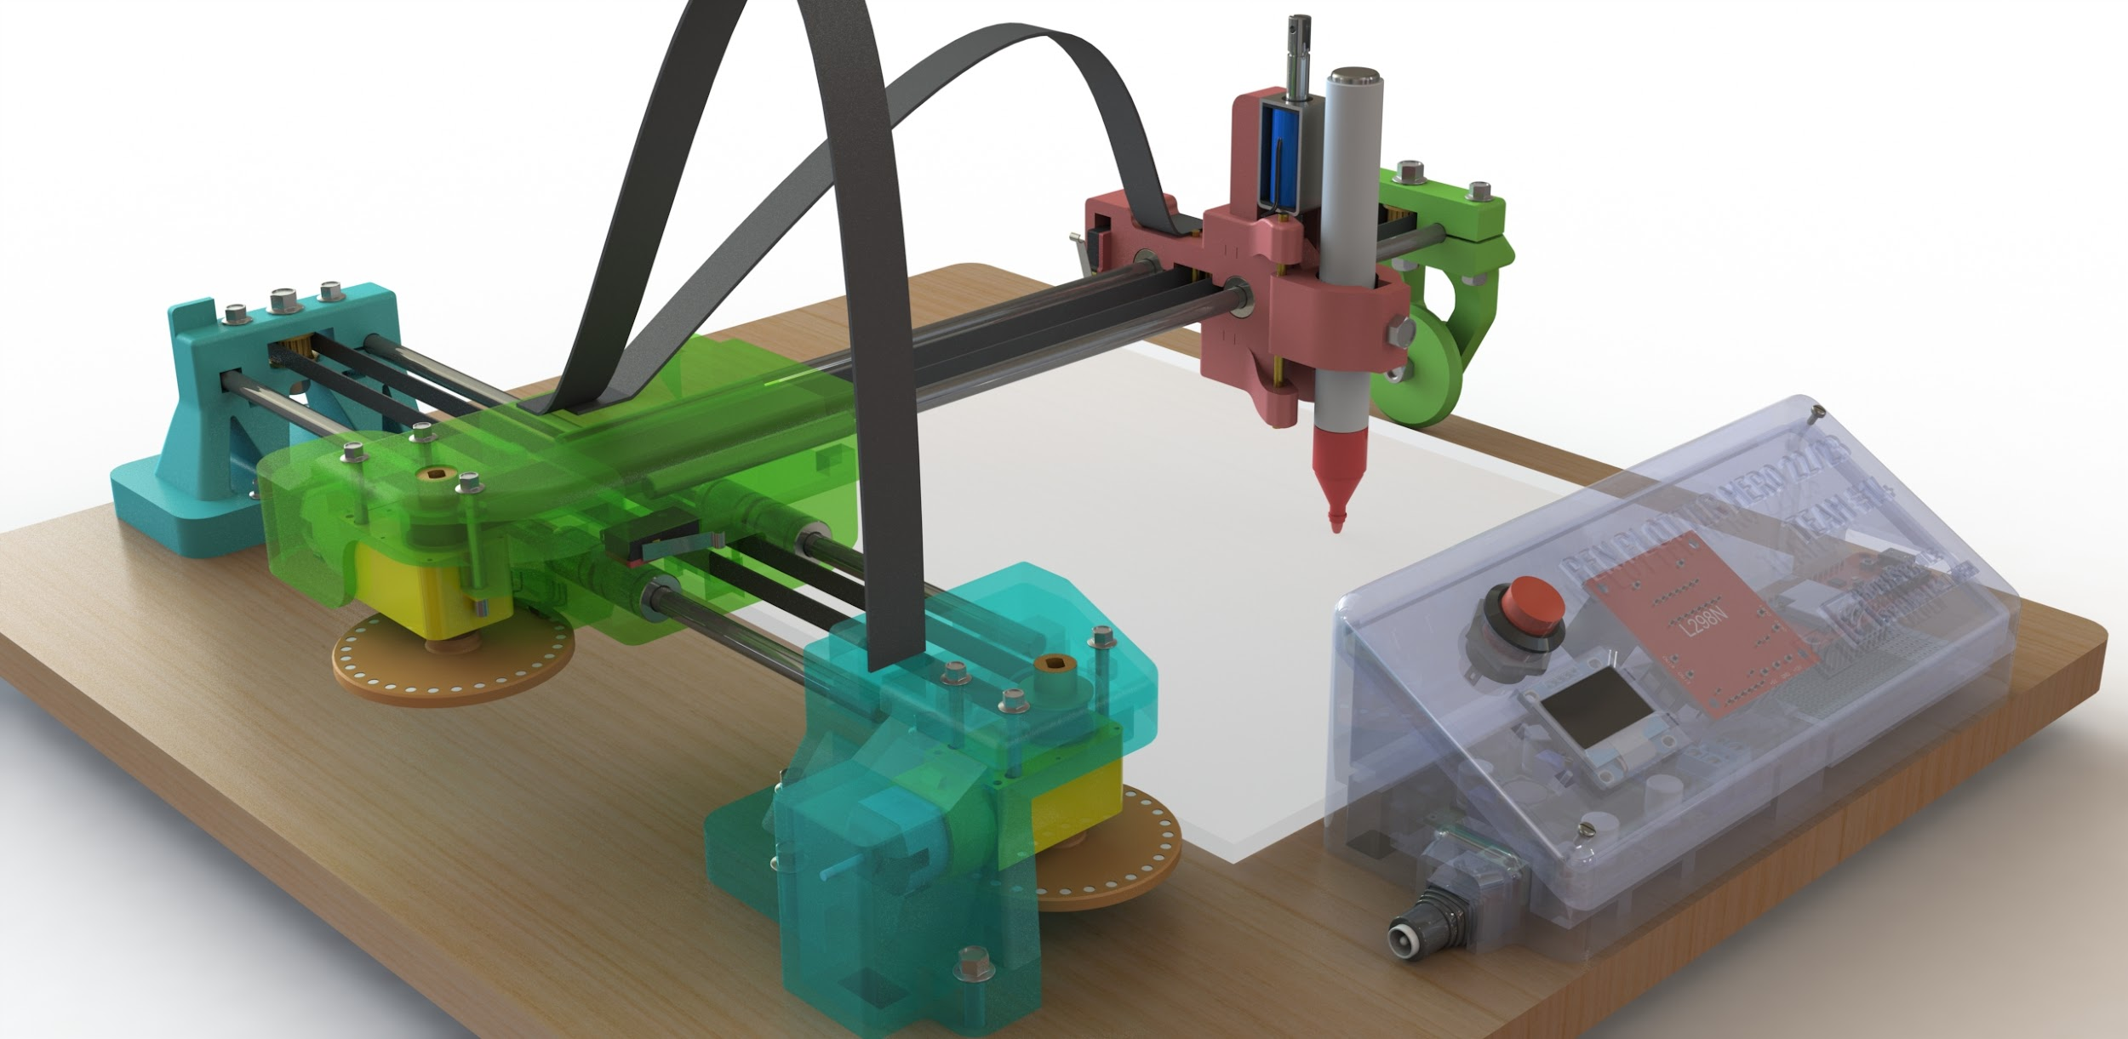
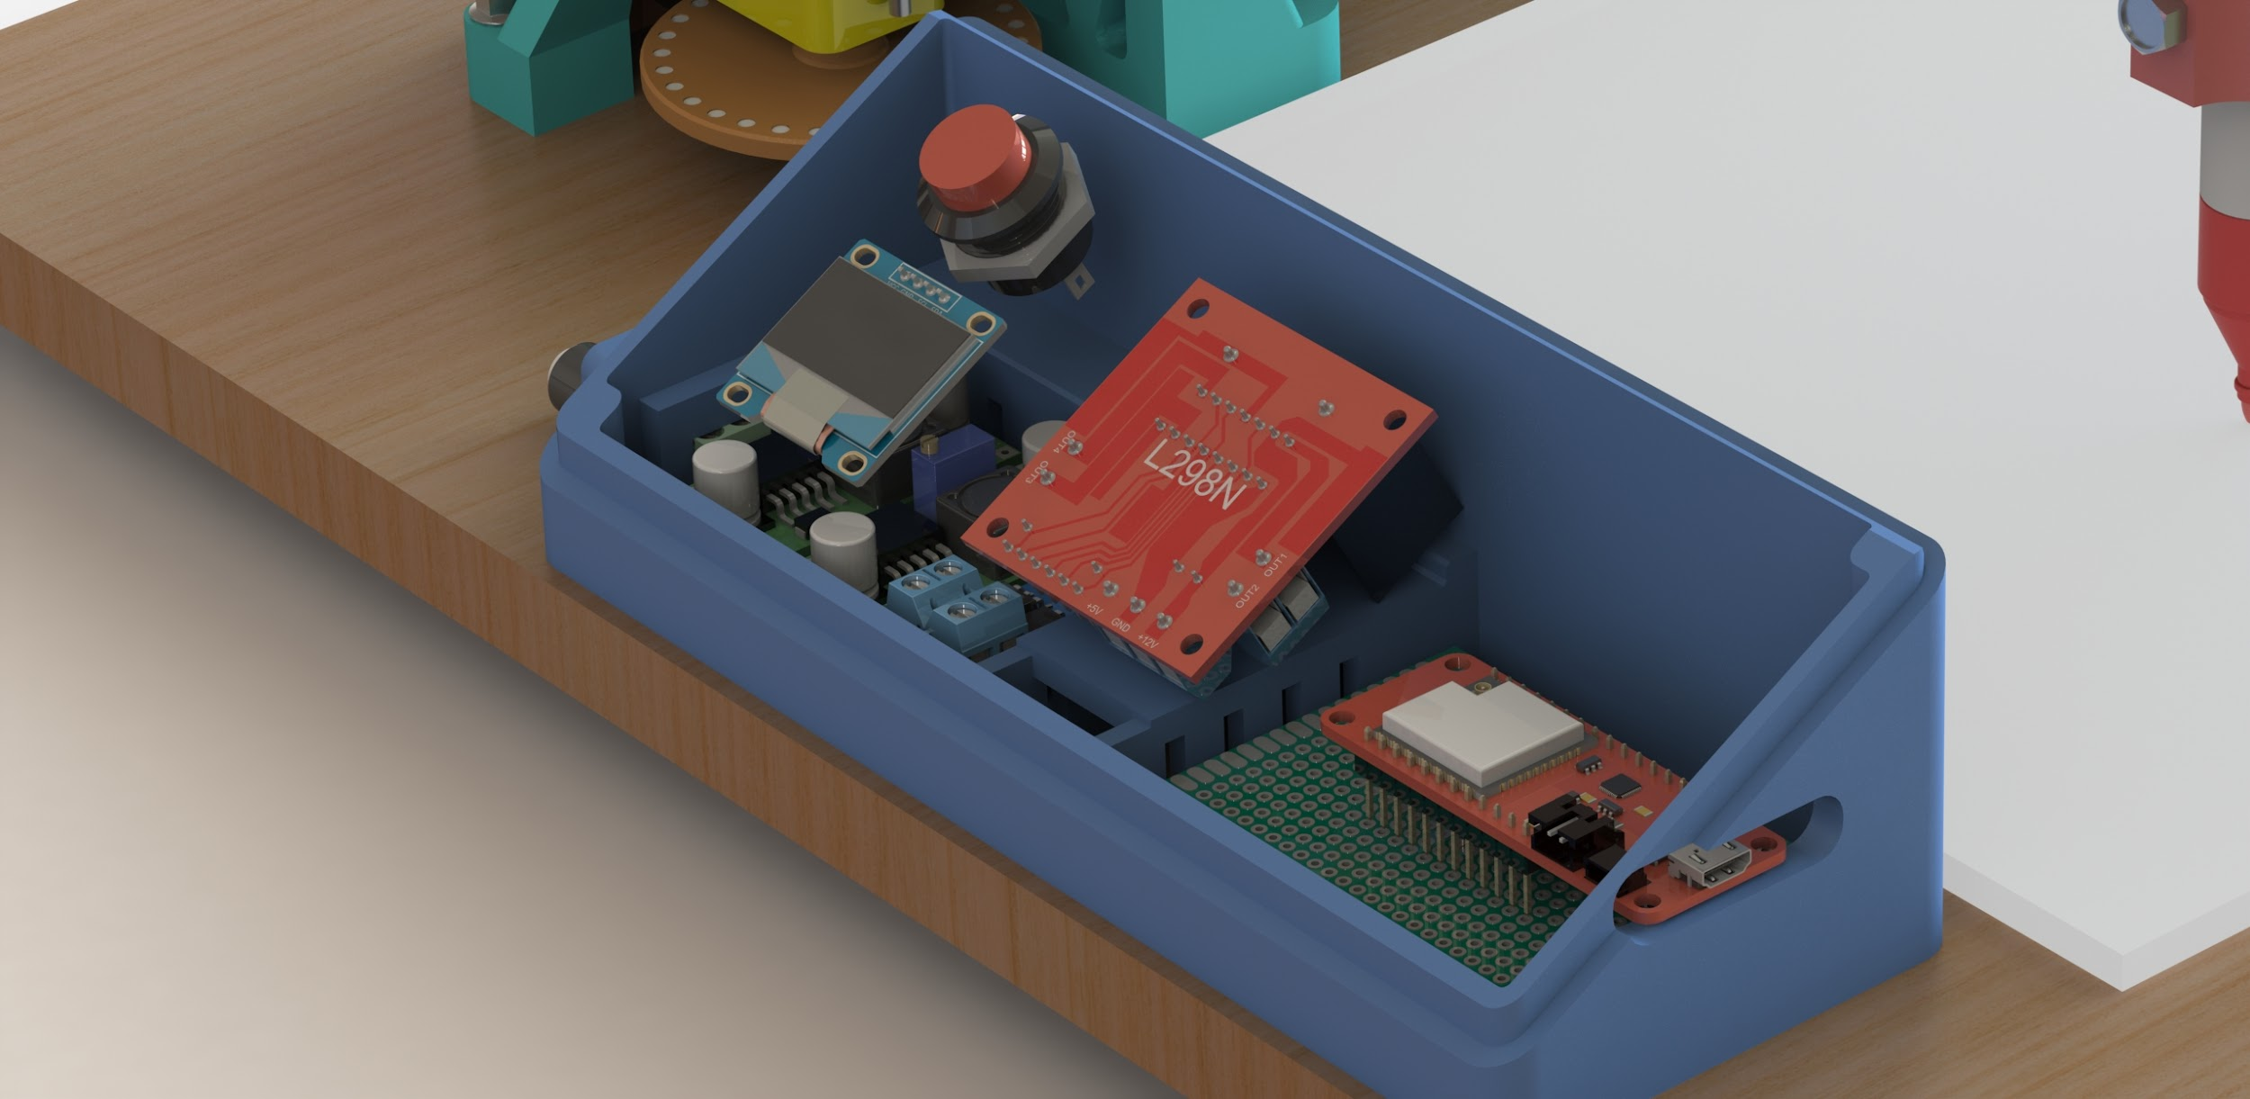
Key design decisions
Magnetic Encoder disk
Hall sensor 1
Design of magnetic encoder disk
The magnetic encoder was designed such that hall sensors analyzed the rotating motions of DC geared motors into linear movements in the XY plane.
Enclosure for Electronic circuitry
To hide all the wiring network and electronic circuit components, we designed an enclosure. This enclosure has an OLED display , an Energency Stop button along with a ON/OFF Switch on side profile of the housing.
Hall sensor 2
DC Geared motor

Slide 19
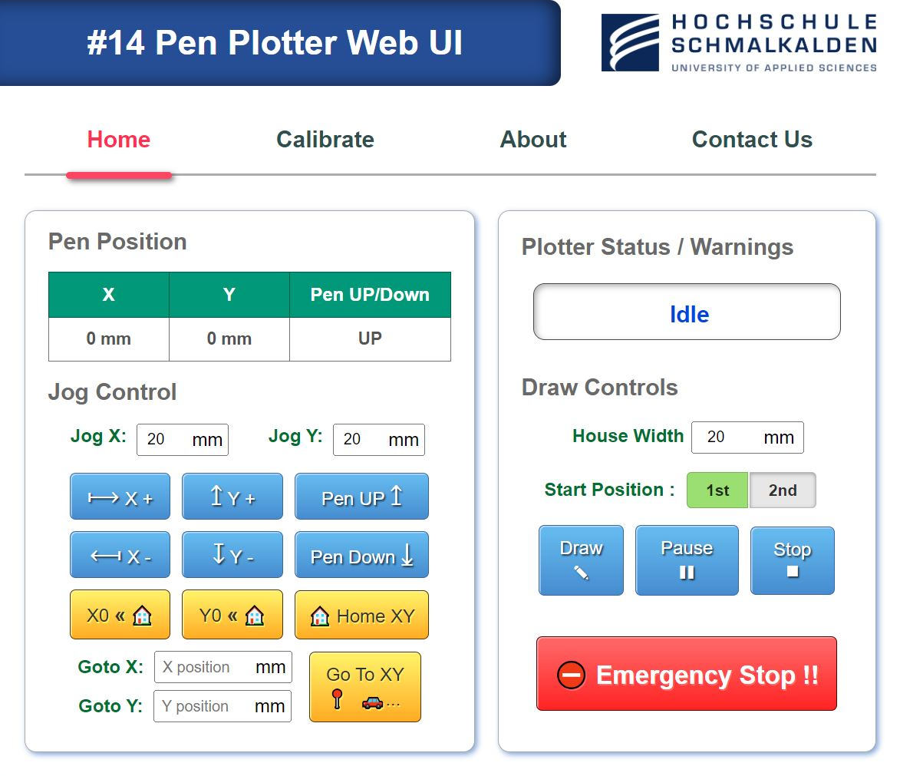
Key design decisions
Graphical User Interface and its features
Using HTML code, we have designed a web user interface which has the following features:
Control the movements of pen carriage in XY plane
Placing the carriage in the drawing area at the specified X, Y coordinates as well as the Home location (X=0, Y=0).
Decision making regarding House width, Start position (Point 1 or point 2 of the Nikolaus Haus).
Raising or lowering the pen against the drawing surface.

Slide 20
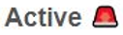
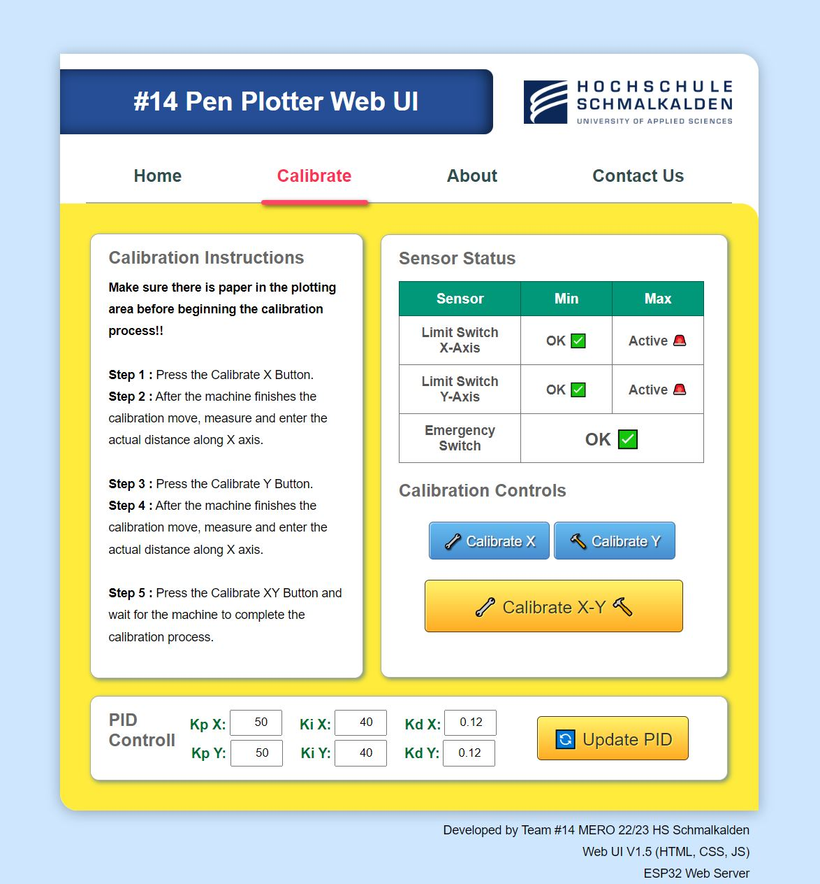
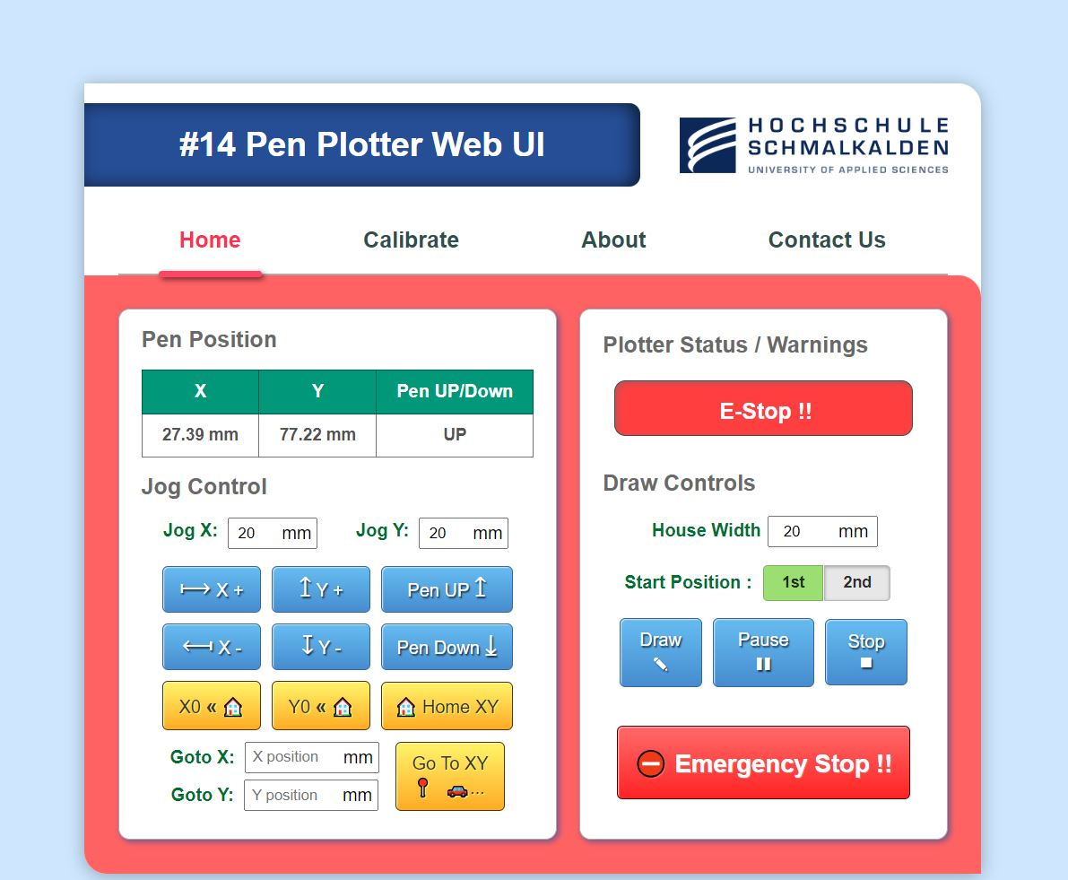
Key design decisions
Graphical User Interface and its features
The status of specific Limit Switches changes to “ " when the X or Y carriage slides at the extreme boundaries of the XY plane, and the Webpage blinks yellow.
Either click the "Emergency button" on the webpage or hold down the "red button" on the Circuitry enclosure for 2 seconds to entirely stop the plotter's activity. This results in a red-blinking website.

Slide 21
Key design decisions
Control system design
The PID (Proportional-Integral-Derivative) control system plays a crucial role in the operation of pen plotters, ensuring accurate and precise positioning of the pen during plotting.
It ensures accurate pen positioning by continuously adjusting the motor movements.
Minimizes the error between the desired and actual positions,
Providing proportional control for immediate response,
Integral control to eliminate steady-state errors, and
Derivative control to dampen oscillations.
Proper tuning of the PID controller allows the plotter to maintain stability, adapt to changing conditions, and deliver precise and high-quality plot outputs.

Slide 22
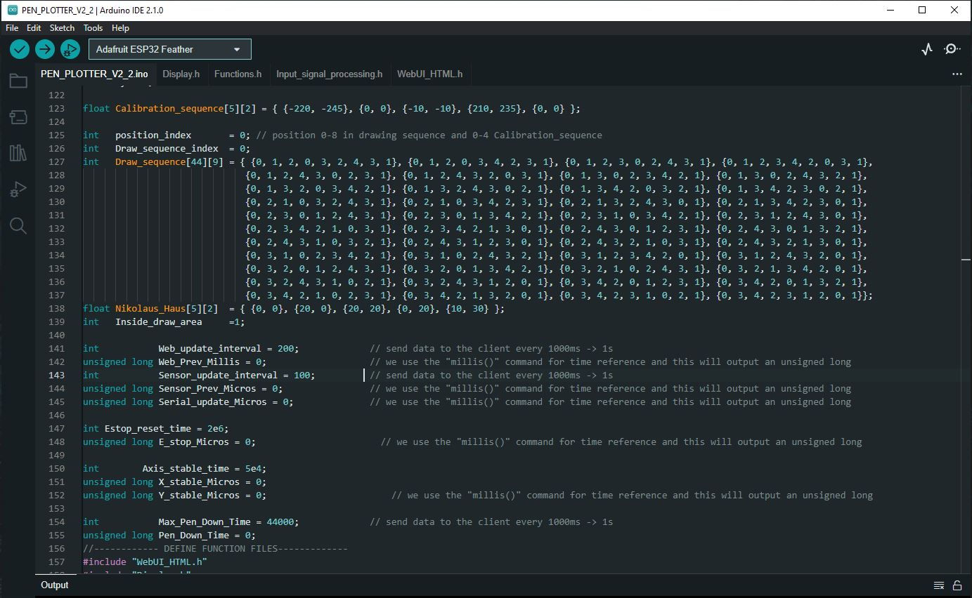
Programming
The Arduino IDE 2.1.0 software is used as a base software for the execution of all the codes related to
Movements in X-Y plane
Speed control of DC geared motors
Calibration of distances covered in the XY plane.
Filtration of signals for unwanted noise
Web page designed for all the relevant tasks related to XY Pen plotter.
All the possible combinations of drawing Nikolaus Haus (44 combinations using each Start points)

Slide 23
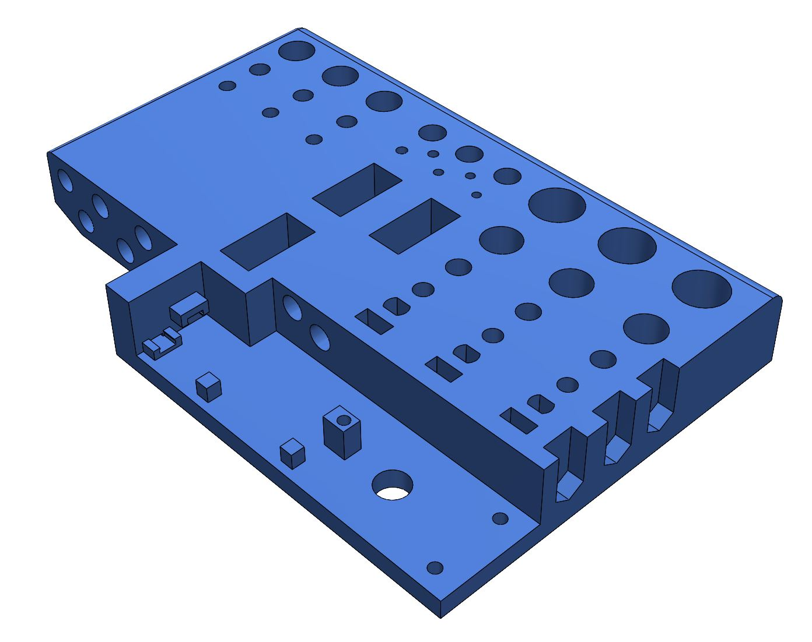
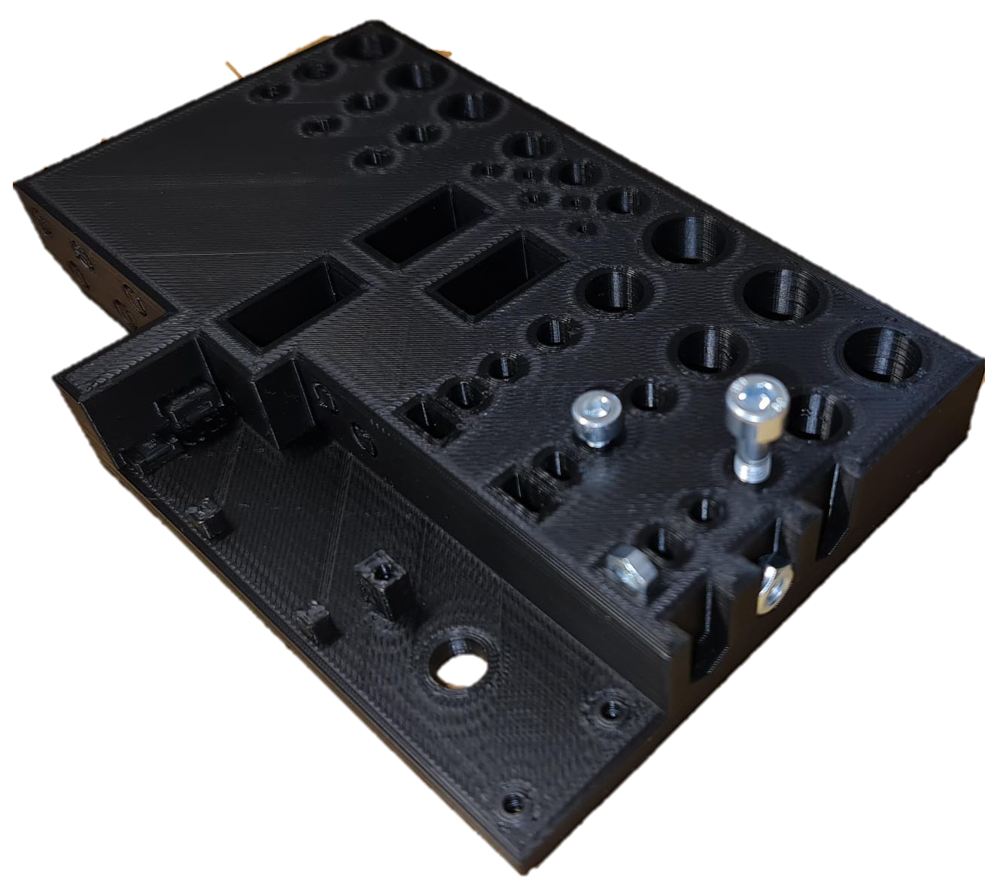
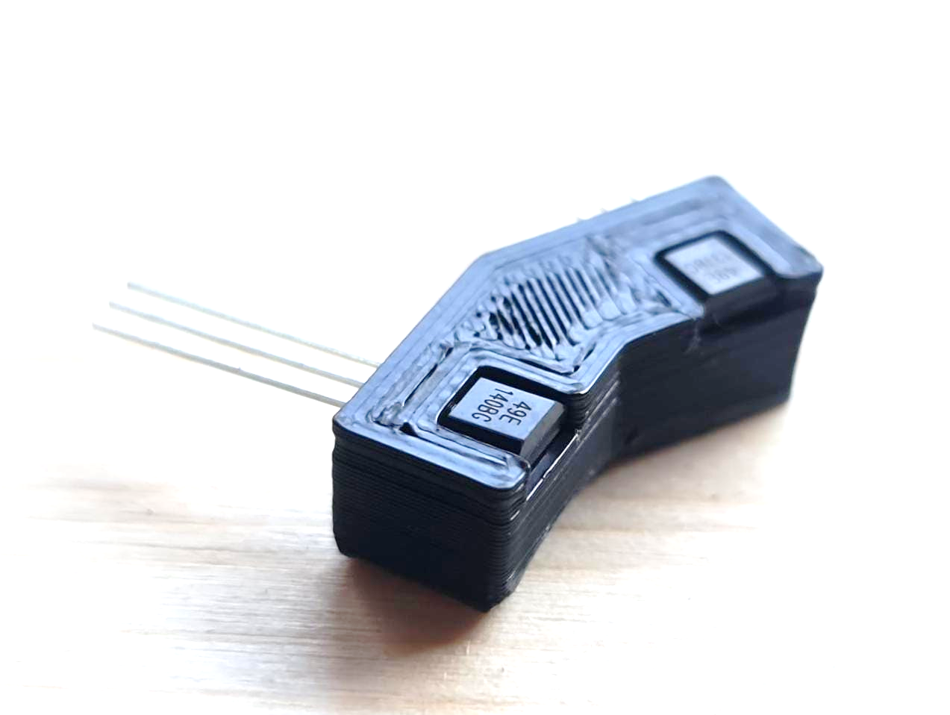
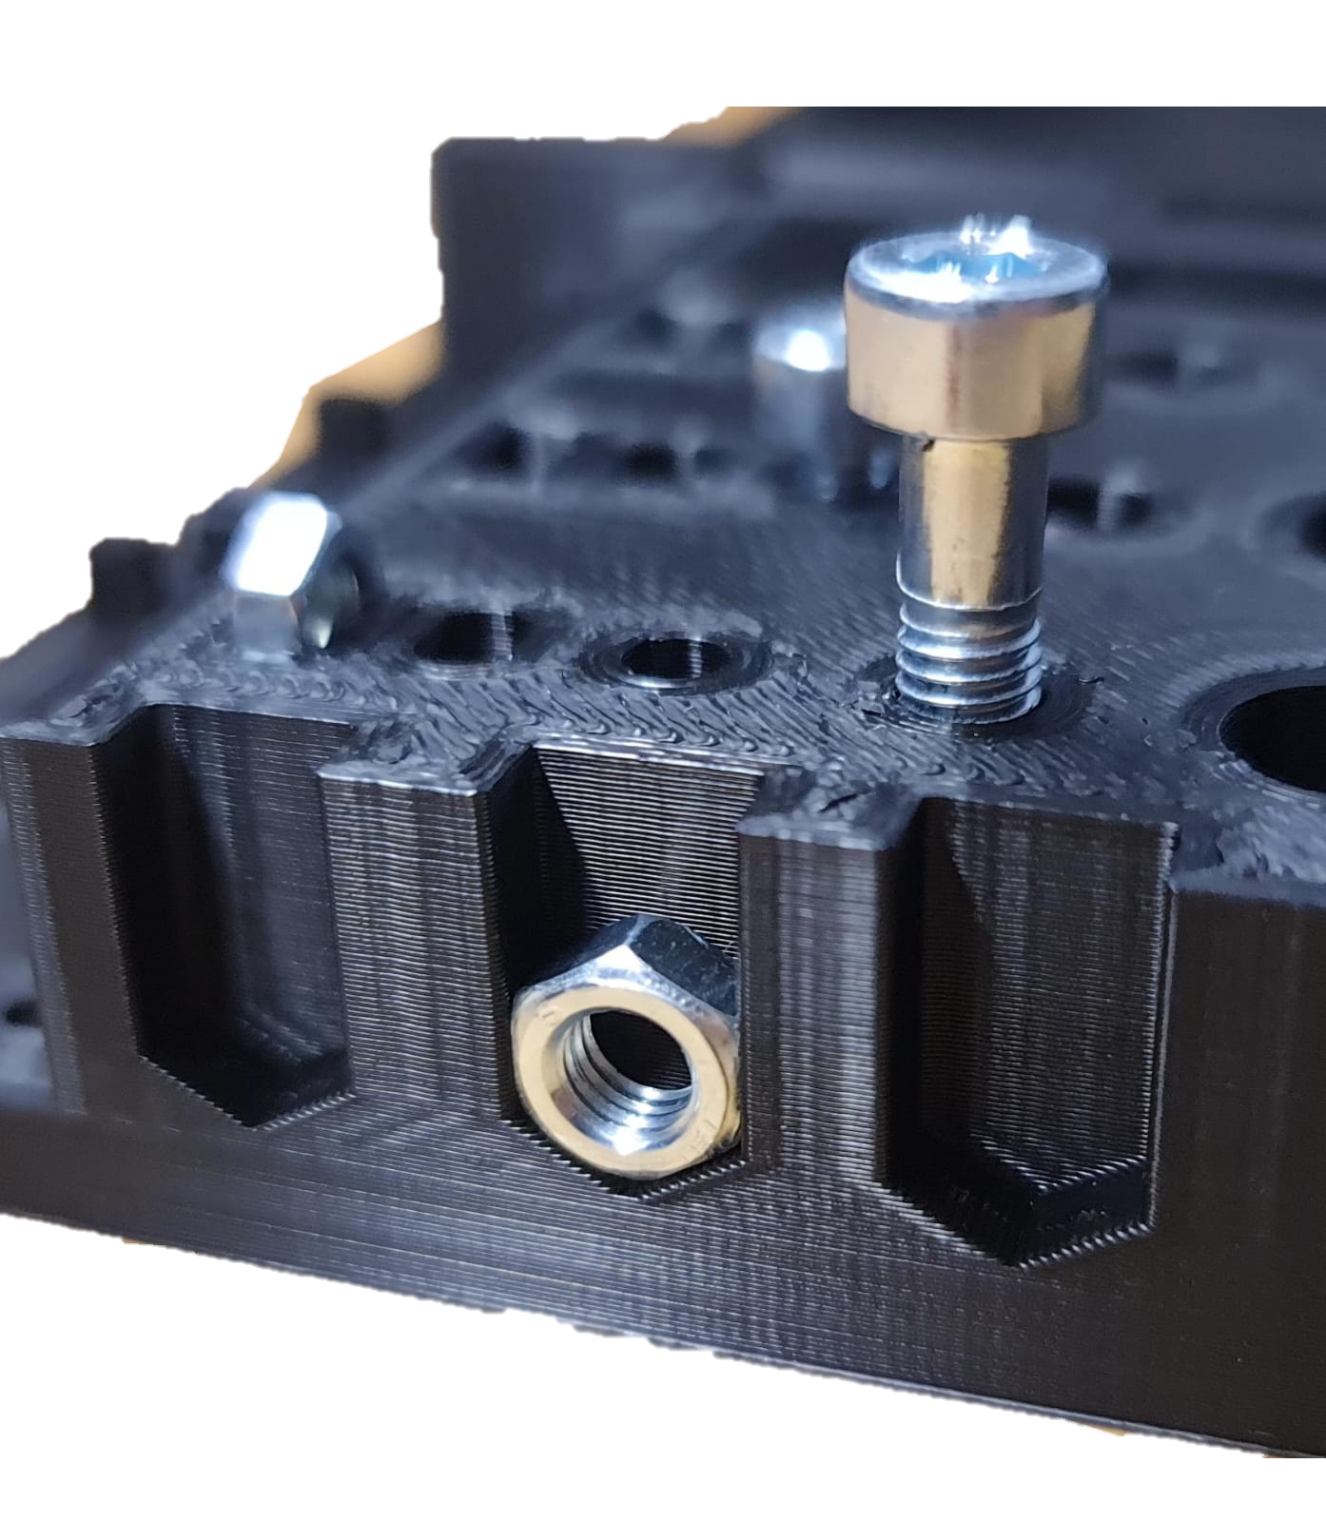
Development and Fabrication Stage

Slide 24
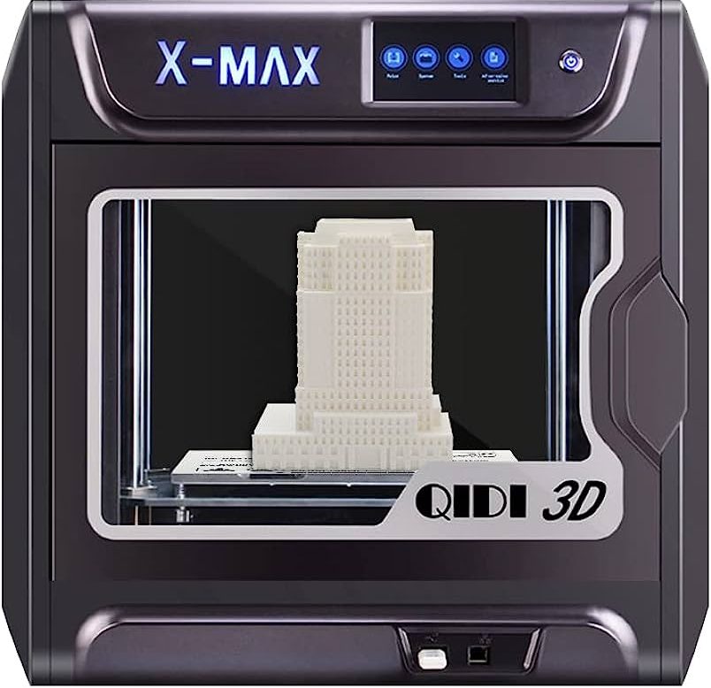
Selection of materials
PLA filament for 3D printing
In the common FDM printing process, PLA(Polylactic Acid) is the perfect entry-level filament and can be easily processed by any standard 3D printer.
PLA has been chosen for due to:
Good printability
Lower distortion (warping) during printing.
Ease of use
Affordability, and
Compatibility with 3D printing technology
Eco-friendliness
All the 3D designed components were printed in “QIDI TECH X-MAX 3D Printer” available in the AKT lab, Haus D.
{PLA is made from regenerative raw materials such as corn starch and is therefore one of the so-called "biocompatible plastics". (for speaking part only, will be removed during presentation)}

Slide 25
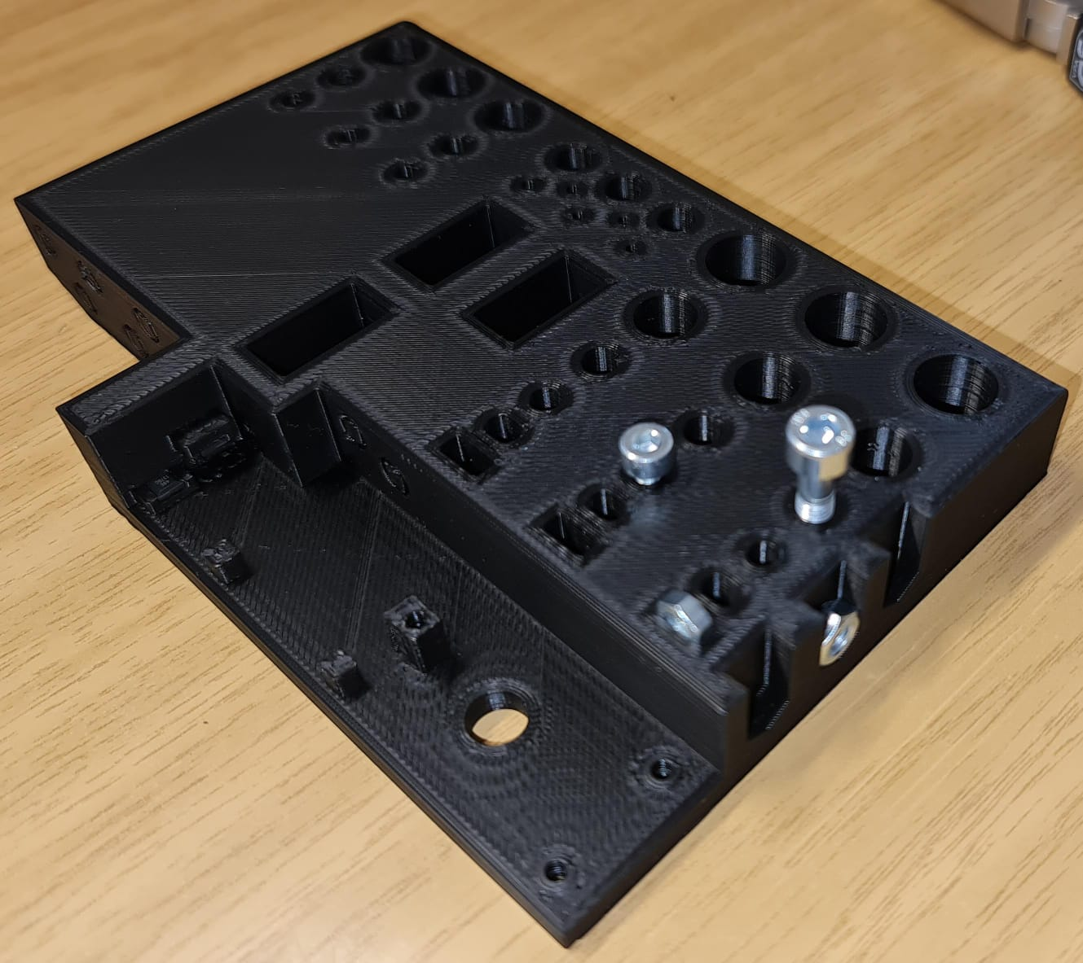


Use of Testpiece
After the Mechanical design completion, the test piece was printed at first to emphasize the need for accuracy and to ensure proper functionality and alignment.
Relevant information received from test piece was used to rectify and improve the design.
This helps in identifying any issues or performance gaps early in the design process and reduce the need for rework later on.

Slide 26


Challenges faced during Development Stage
Issues related Wire routing
One of the main tasks in an electronic component is hiding the wiring network. Hiding the wiring network enhances the visual appeal of the electronic device.
Exposed wires can create a cluttered & unattractive appearance, which may detract from the overall design and professionalism of the product.
Exposed wires are susceptible to being snagged, bent, or pulled impact by accidental tampering, which can result in electrical malfunctions or complete failure of the device.
In order to mitigate these concerns, we had designed an enclosure to house all the wiring connections and electronic components.
Plastic cable conduits was used to guide a group of multistrand wires
Plastic Cable Conduits
Wire Channel

Slide 27

Challenges faced during Development Stage
Problem related to Noise in Sensor output signals
In our design, we have used Hall sensors in conjunction with a magnetic encoder disk to detect changes in the magnetic field as the disk rotates. The magnetic encoder disk consists of 30 alternating magnetic poles, typically north and south, arranged at equal angular intervals around the disk's circumference.
When a magnetic pole passes by a Hall sensor, it induces a voltage in the sensor due to the Hall effect. The output signals from the Hall sensors can be processed by microcontrollers to interpret the position and movement of the encoder disk.
However, the noise in the system introduced inconsistency in the position sensing leading to inaccurate plotting and deviations from the intended plot path.
To reduce noise errors, we ensured proper wiring techniques to minimize ground loops and reduce noise coupling.
The implementation of a digital Butterworth filter, a signal filtering technique was a turning point in our design. It removed high-frequency noise components at a greater extent.
Also, we shielded all the wires in a Silver-Plated Copper Braid to protect the sensor signals from external electromagnetic interference.

Slide 28

Testing & Iteration

Slide 29
Testing procedures
Paste Validation & Verification protocol/test data and write some notes.

Slide 30
Performance testing & Calibration
This process involves calibration of key parameters such as motor jog size, pen movement in XY plane, and plot alignment.
Calibration required multiple iterations to achieve optimal performance, with each iteration involving adjustments and retesting.
ADD more data***

Slide 31

Conclusion

Slide 32


Task: Plot Nikolaus Haus
Finally, after completing design stage, fabrication of components, hours of coding and innumerable test runs, we were able to plot the Nikolaus Haus.
Given the starting point for Nikolaus Haus, the Pen plotter could plot a total of 44 combinations through Point 1 or Point 2 (total 88 combinations) without repeating the drawing patterns.

Slide 33
Future Scope
Pen plotters have a bright future with lots of room for innovation and growth. In order to create immersive and interactive artistic experiences:
Use of higher-quality DC geared motors with finer gear ratios to achieve more accurate positioning and smoother movement.
Working on the design and making it more reliable and efficient so that the vibrations can be reduced and quality of the drawing can be improved.
Future designs might focus on reducing the size and weight of the plotter while maintaining its functionality and performance.

Slide 34
Let’s demonstrate

Slide 35


